Slide 1
Managing Liquidity

Slide 2
Meeting Liquidity Needs
Bank Liquidity
  A bank’s capacity to acquire immediately available funds at a reasonable price
Firms can acquire liquidity in three distinct ways:
  Selling assets
  New borrowings
  New stock issues

Slide 3
Meeting Liquidity Needs
How effective each liquidity source is at meeting the institution’s liquidity needs, depends on:
  Market conditions
  The market’s perception of risk at the institution as well as in the marketplace
  The market’s perception of bank management and its strategic direction
  The current economic environment

Slide 4
Meeting Liquidity Needs
Holding Liquid Assets
  “Cash Assets”
    Do not earn any interest
    Represents a substantial opportunity cost for banks
      Banks attempt to minimize the amount of cash assets held and hold only those required by law or for operational needs
  Liquid Assets
    Can be easily and quickly converted into cash with minimum loss

Slide 5
Meeting Liquidity Needs
Holding Liquid Assets
  “Cash Assets” do not generally satisfy a bank’s liquidity needs
    If the bank holds the minimum amount of cash assets required, an unforeseen drain on vault cash (perhaps from an unexpected withdrawal) will cause the level of cash to fall below the minimum for legal and operational requirements

Slide 6
Meeting Liquidity Needs
Holding Liquid Assets
  Banks hold cash assets to satisfy four objectives:
    To meet customers’ regular transaction needs
    To meet legal reserve requirements
    To assist in the check-payment system
    To purchase correspondent banking services

Slide 7
Meeting Liquidity Needs
Holding Liquid Assets
  Banks own five types of liquid assets
    Cash and due from banks in excess of requirements
    Federal funds sold and reverse repurchase agreements
    Short-term Treasury and agency obligations
    High-quality short-term corporate and municipal securities
    Government-guaranteed loans that can be readily sold

Slide 8
Meeting Liquidity Needs
Borrowing Liquid Assets
  Banks can provided for their liquidity by borrowing
  Banks historically have had an advantage over non-depository institutions in that they could fund their operations with relatively low-cost deposit accounts

Slide 9
Meeting Liquidity Needs
Objectives of Cash Management
  Banks must balance the desire to hold a minimum amount of cash assets while meeting the cash needs of its customers
  The fundamental goal is to accurately forecast cash needs and arrange for readily available sources of cash at minimal cost

Slide 10
Reserve Balances at the Federal Reserve Bank
Banks hold deposits at the Federal Reserve because:
  The Federal Reserve imposes legal reserve requirements and deposit balances qualify as legal reserves
  To help process deposit inflows and outflows caused by check clearings, maturing time deposits and securities, wire transfers, and other transactions

Slide 11
Reserve Balances at the Federal Reserve Bank
Required Reserves and Monetary Policy
  The purpose of required reserves is to enable the Federal Reserve to control the nation’s money supply
  The Fed has three distinct monetary policy tools:
    Open market operations
    Changes in the discount rate
    Changes in the required reserve ratio

Slide 12
Reserve Balances at the Federal Reserve Bank
Required Reserves and Monetary Policy
  Example
    A required reserve ratio of 10% means that a bank with $100 in demand deposits outstanding must hold $10 in legal required reserves in support of the DDAs
      The bank can thus lend out only 90% of its DDAs
    If the bank has exactly $10 in legal reserves, the reserves do not provide the bank with liquidity
      If the bank has $12 in legal reserves, $2 is excess reserves, providing the bank with $2 in immediately available funds

Slide 13
Reserve Balances at the Federal Reserve Bank
Impact of Sweep Accounts on Required Reserve Balances
  Under Reg. D, banks have reserve requirements of 10% on demand deposits, ATS, NOW, and other checkable deposit (OCD) accounts
  not reservable

Slide 14
Reserve Balances at the Federal Reserve Bank
Impact of Sweep Accounts on Required Reserve Balances
  MMDAs are considered personal saving deposits and have a zero required reserve requirement ratio

Slide 15
Reserve Balances at the Federal Reserve Bank
Impact of Sweep Accounts on Required Reserve Balances
  Sweep accounts are accounts that enable depository institutions to shift funds from OCDs, which are reservable, to MMDAs or other accounts, which are not reservable

Slide 16
Reserve Balances at the Federal Reserve Bank
Impact of Sweep Accounts on Required Reserve Balances
  Sweep Accounts
    Two Types
      Weekend Program
        Reclassifies transaction deposits as savings deposits at the close of business on Friday and back to transaction accounts at the open on Monday
        On average, this means that for three days each week, the bank does not need to hold reserves against those balances

Slide 17
Reserve Balances at the Federal Reserve Bank
Impact of Sweep Accounts on Required Reserve Balances
  Sweep Accounts
    Two Types
      Threshold Account
        The bank’s computer moves the customer’s DDA balance into an MMDA when the dollar amount reaches some minimum and returns funds as needed
        The number of transfers is limited to 6 per month, so the full amount of funds must be moved back into the DDA on the sixth transfer of the month

Slide 18
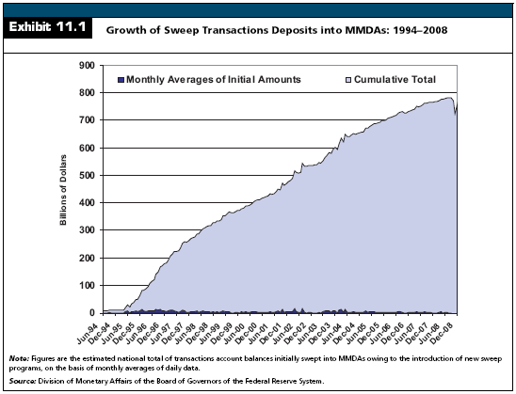

Slide 19
Meeting Legal Reserve Requirements
Required reserves can be met over a two-week period
There are three elements of required reserves:
  The dollar magnitude of base liabilities
  The required reserve fraction
  The dollar magnitude of qualifying cash assets

Slide 20
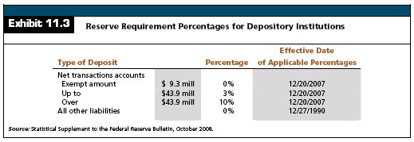
Meeting Legal Reserve Requirements

Slide 21
Meeting Legal Reserve Requirements
Historical Problems with Reserve Requirements
  Reserve requirements varied by type of bank charter and by state.
  Non-Fed member banks had lower reserve requirements than Fed member banks

Slide 22
Meeting Legal Reserve Requirements
Lagged Reserve Accounting
  Computation Period
    Consists of two one-week reporting periods beginning on a Tuesday and ending on the second Monday thereafter
  Maintenance Period
    Consists of 14 consecutive days beginning on a Thursday and ending on the second Wednesday thereafter

Slide 23
Meeting Legal Reserve Requirements
Lagged Reserve Accounting
  Reserve Balance Requirements
    The balance to be maintained in any given maintenance period is measured by:
      Reserve requirements on the reservable liabilities calculated as of the computation period that ended 17 days prior to the start of the maintenance period
      Less vault cash as of the same computation period

Slide 24
Meeting Legal Reserve Requirements
Lagged Reserve Accounting
  Reserve Balance Requirements
    Both vault cash and Federal Reserve Deposits qualify as reserves
    The portion that is not met by vault cash is called the reserve balance requirement

Slide 25
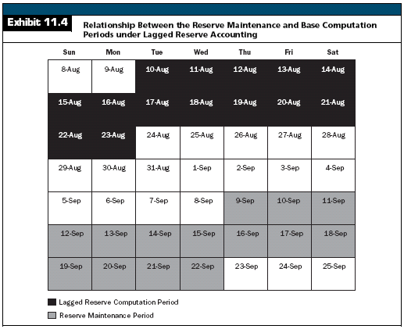

Slide 26
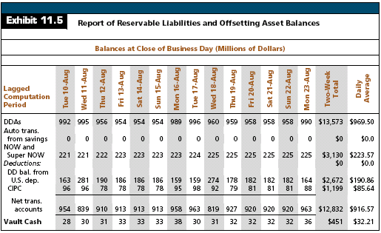

Slide 27
Meeting Legal Reserve Requirements
An Application: Reserve Calculation Under LRA
  Four steps:
    Calculate daily average balances outstanding during the lagged computation period.
    Apply the reserve percentages.
    Subtract vault cash.
    Add or subtract the allowable reserve carried forward from the prior period

Slide 28
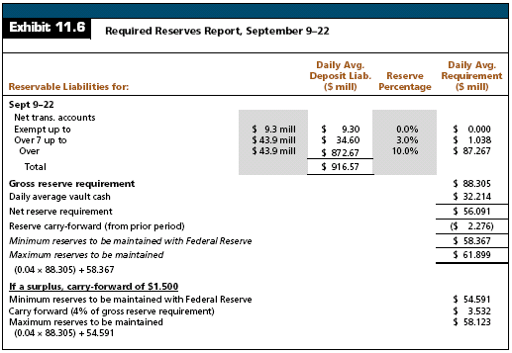

Slide 29
Meeting Legal Reserve Requirements
Correspondent Banking Services
  System of interbank relationships in which the correspondent bank (upstream correspondent) sells services to the respondent bank (downstream correspondent)

Slide 30
Meeting Legal Reserve Requirements
Correspondent Banking Services
  Common Correspondent Banking Services
    Check collection, wire transfer, coin and currency supply
    Loan participation assistance
    Data processing services
    Portfolio analysis and investment advice
    Federal funds trading
    Securities safekeeping
    Arrangement of purchase or sale of securities
    Investment banking services
    Loans to directors and officers
    International financial transactions

Slide 31
Meeting Legal Reserve Requirements
Correspondent Banking Services
  Banker’s Bank
    A firm, often a cooperative owned by independent commercial banks, that provides correspondent banking services to commercial banks and not to commercial or retail deposit and loan customers

Slide 32
Liquidity Planning
Short-Term Liquidity Planning
  Objective is to manage a legal reserve position that meets the minimum requirement at the lowest cost

Slide 33
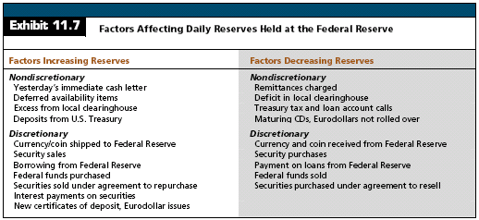
Liquidity Planning

Slide 34
Liquidity Planning
Managing Float
  During any single day, more than $100 million in checks drawn on U.S. commercial banks is waiting to be processed
    Individuals, businesses, and governments deposit the checks but cannot use the proceeds until banks give their approval, typically in several days
    Checks in process of collection, called float, are a source of both income and expense to banks

Slide 35
Liquidity Planning
Liquidity versus Profitability
  There is a short-run trade-off between liquidity and profitability
    The more liquid a bank is, the lower are its return on equity and return on assets, all other things equal
      In a bank’s loan portfolio, the highest yielding loans are typically the least liquid
      The most liquid loans are typically government-guaranteed loans

Slide 36
Liquidity Planning
The Relationship Between Liquidity, Credit Risk, and Interest Rate Risk
  Liquidity risk for a poorly managed bank closely follows credit and interest rate risk
    Banks that experience large deposit outflows can often trace the source to either credit problems or earnings declines from interest rate gambles that backfired
  Potential liquidity needs must reflect estimates of new loan demand and potential deposit losses

Slide 37
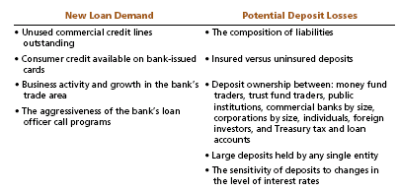
Liquidity Planning
The Relationship Between Liquidity, Credit Risk, and Interest Rate Risk

Slide 38
Traditional Aggregate Measures of Liquidity Risk
Asset Liquidity Measures
  The most liquid assets mature near term and are highly marketable
  Any security or loan with a price above par, in which the bank could report a gain at sale, is viewed as highly liquid
  Liquidity measures are normally expressed in percentage terms as a fraction of total assets

Slide 39
Traditional Aggregate Measures of Liquidity Risk
Asset Liquidity Measures
  Highly Liquid Assets
    Cash and due from banks in excess of required holdings
    Federal funds sold and reverse RPs.
    U.S. Treasury securities and agency obligations maturing within one year
    Corporate obligations and municipal securities maturing within one year and rated Baa and above
    Loans that can be readily sold and/or securitized

Slide 40
Traditional Aggregate Measures of Liquidity Risk
Asset Liquidity Measures
  Pledging Requirements
    Not all of a bank’s securities can be easily sold
      Like their credit customers, banks are required to pledge collateral against certain types of borrowings
      U.S. Treasuries or municipals normally constitute the least-cost collateral and, if pledged against debt, cannot be sold until the bank removes the claim or substitutes other collateral

Slide 41
Traditional Aggregate Measures of Liquidity Risk
Asset Liquidity Measures
  Pledging Requirements
    Collateral is required against four different liabilities:
      Repurchase agreements
      Discount window borrowings
      Public deposits owned by the U.S. Treasury or any state or municipal government unit
      FLHB advances

Slide 42
Traditional Aggregate Measures of Liquidity Risk
Asset Liquidity Measures
  Loans
    Many banks and bank analysts monitor loan-to-deposit ratios as a general measure of liquidity
    Loans are presumably the least liquid of assets, while deposits are the primary source of funds
    A high ratio indicates illiquidity because a bank is fully loaned up relative to its stable funding

Slide 43
Traditional Aggregate Measures of Liquidity Risk
Liability Liquidity Measures
  Liability Liquidity:
    The ease with which a bank can issue new debt to acquire clearing balances at reasonable costs
    Measures typically reflect a bank’s asset quality, capital base, and composition of outstanding deposits and other liabilities

Slide 44
Traditional Aggregate Measures of Liquidity Risk
Liability Liquidity Measures
  Commonly used measures:
    Total equity to total assets
    Risk assets to total assets
    Loan losses to net loans
    Reserve for loan losses to net loans
    The percentage composition of deposits
    Total deposits to total liabilities
    Core deposits to total assets
    Federal funds purchased and RPs to total liabilities
    Commercial paper and other short-term borrowings to total liabilities

Slide 45
Traditional Aggregate Measures of Liquidity Risk
Liability Liquidity Measures
  Core Deposits
    A base level of deposits a bank expects to remain on deposit, regardless of the economic environment
  Volatile Deposits
    The difference between actual current deposits and the base estimate of core deposits

Slide 46
Longer-Term Liquidity Planning
This stage of liquidity planning involves projecting funds needs over the coming year and beyond if necessary
  Forecasts in deposit growth and loan demand are required
  Projections are separated into three categories: base trend, short-term seasonal, and cyclical values
  The analysis assesses a bank’s liquidity gap, measured as the difference between potential uses of funds and anticipated sources of funds, over monthly intervals

Slide 47
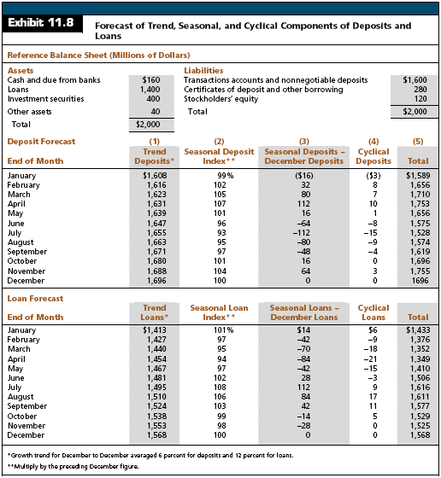

Slide 48
Longer-Term Liquidity Planning
The bank’s monthly liquidity needs are estimated as the forecasted change in loans plus required reserves minus the forecast change in deposits:
Liquidity needs = Forecasted Δloans + ΔRequired reserves - Forecasted Δdeposits

Slide 49
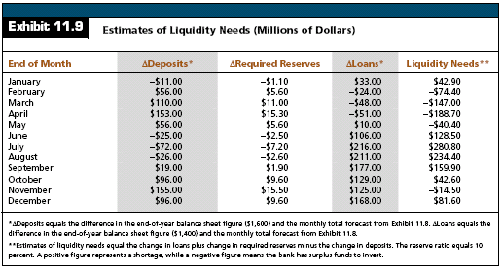
Longer-Term Liquidity Planning

Slide 50
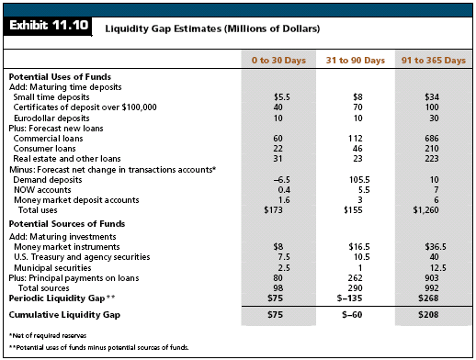
Longer-Term Liquidity Planning

Slide 51
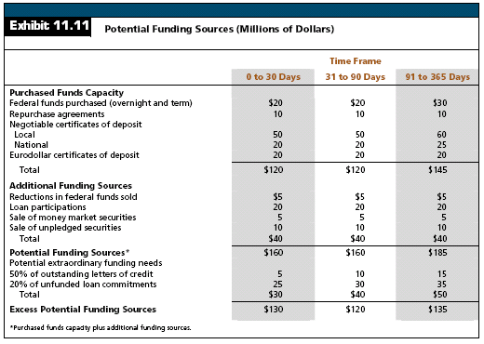
Longer-Term Liquidity Planning

Slide 52

Longer-Term Liquidity Planning
Considerations in the Selection of Liquidity Sources
  The costs should be evaluated in present value terms because interest income and expense may arise over time
  The choice of one source over another often involves an implicit interest rate forecast

Slide 53
Contingency Funding
Financial institutions must have carefully designed contingency plans that address their strategies for handling unexpected liquidity crises and outline the appropriate procedures for dealing with liquidity shortfalls occurring under abnormal conditions

Slide 54
Contingency Funding
Contingency Planning
  A contingency plan should include:
    A narrative section that addresses the senior officers who are responsible for dealing with external constituencies, internal and external reporting requirements, and the types of events that trigger specific funding needs

Slide 55
Contingency Funding
Contingency Planning
  A contingency plan should include:
    A quantitative section that assesses the impact of potential adverse events on the institution’s balance sheet (changes), incorporates the timing of such events by assigning deposit and wholesale funding run-off rates, identifies potential sources of new funds, and forecasts the associated cash flows across numerous short-term and long-term scenarios and time intervals

Slide 56
Contingency Funding
Contingency Planning
  A contingency plan should include:
    A section that summarizes the key risks and potential sources of funding, identifies how the modeling will monitored and tested, and establishes relevant policy limits

Slide 57
Contingency Funding
Contingency Planning
  The institution’s liquidity contingency strategy should clearly outline the actions needed to provide the necessary liquidity
  The institution’s plan must consider the cost of changing its asset or liability structure versus the cost of facing a liquidity deficit

Slide 58
Contingency Funding
Contingency Planning
  The contingency plan should prioritize which assets would have to be sold in the event that a crisis intensifies
  The institution’s relationship with its liability holders should also be factored into the contingency strategy
  The institution’s plan should also provide for back-up liquidity

Slide 59
Managing Liquidity

