Slide 1
The Effective Use of Capital

Slide 2
Why Worry About Bank Capital?
Capital requirements reduce the risk of failure by acting as a cushion against losses, providing access to financial markets to meet liquidity needs, and limiting growth
Bank capital-to-asset ratios have fallen from about 20% a hundred years ago to around 8% today

Slide 3
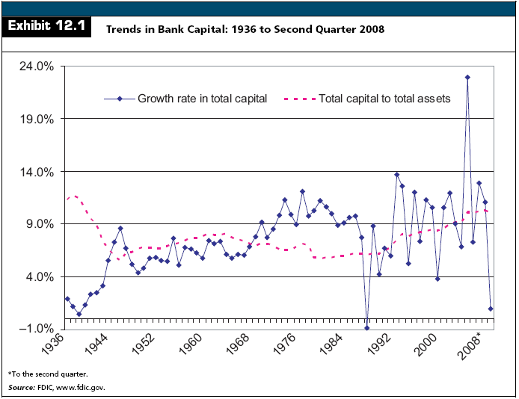

Slide 4
Risk-Based Capital Standards
Historically, the minimum capital requirements for banks were independent of the riskiness of the bank
Prior to 1990, banks were required to maintain:
  a primary capital-to-asset ratio of at least 5% to 6%, and
  a minimum total capital-to-asset ratio of 6%

Slide 5
Risk-Based Capital Standards
Primary Capital
  Common stock
  Perpetual preferred stock
  Surplus
  Undivided profits
  Contingency and other capital reserves
  Mandatory convertible debt
  Allowance for loan and lease losses

Slide 6
Risk-Based Capital Standards
Secondary Capital
  Long-term subordinated debt
  Limited-life preferred stock
Total Capital
  Primary Capital + Secondary Capital
Capital requirements were independent of a bank’s asset quality, liquidity risk, interest rate risk, operational risk, and other related risks

Slide 7
Risk-Based Capital Standards
The 1986 Basel Agreement
  In 1986, U.S. bank regulators proposed that U.S. banks be required to maintain capital that reflects the riskiness of bank assets
    The Basel Agreement grew to include risk-based capital standards for banks in 12 industrialized nations
    Regulations apply to both banks and thrifts and have been in place since the end of 1992
    Today, countries that are members of the Organization for Economic Cooperation and Development (OECD) enforce similar risk-based requirements on their own financial institutions

Slide 8
Risk-Based Capital Standards
The 1986 Basel Agreement
  A bank’s minimum capital requirement is linked to its credit risk
    The greater the credit risk, the greater the required capital
  Stockholders' equity is deemed to be the most valuable type of capital

Slide 9
Risk-Based Capital Standards
The 1986 Basel Agreement
  Minimum capital requirement increased to 8% total capital to risk-adjusted assets
  Capital requirements were approximately standardized between countries to ‘level the playing field'

Slide 10
Risk-Based Capital Standards
Risk-Based Elements of Basel I
  Classify assets into one of four risk categories
  Classify off-balance sheet commitments into the appropriate risk categories
  Multiply the dollar amount of assets in each risk category by the appropriate risk weight
    This equals risk-weighted assets
  Multiply risk-weighted assets by the minimum capital percentages, currently 4% for Tier 1 capital and 8% for total capital

Slide 11
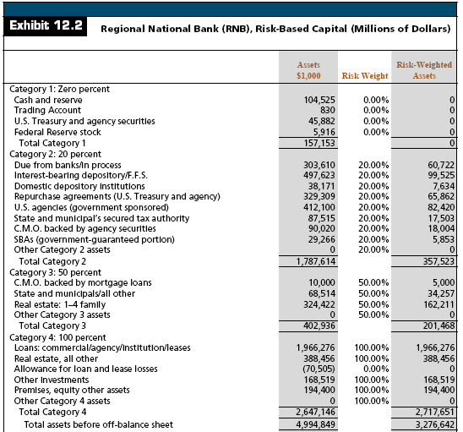

Slide 12
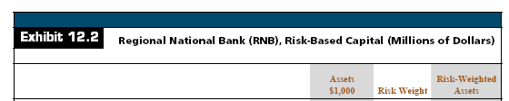
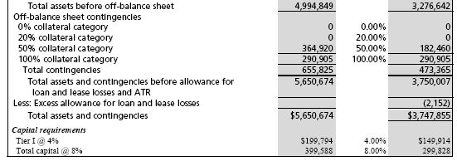
Risk-Based Capital Standards

Slide 13
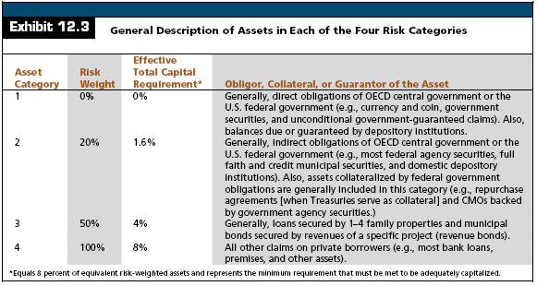
Risk-Based Capital Standards

Slide 14
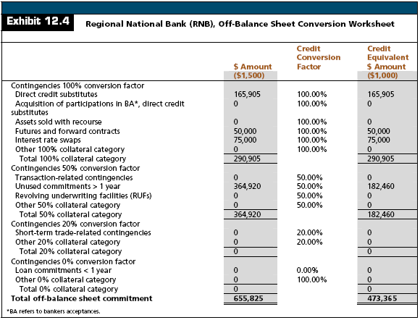

Slide 15
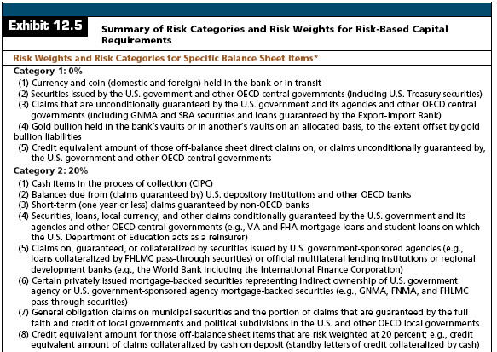

Slide 16

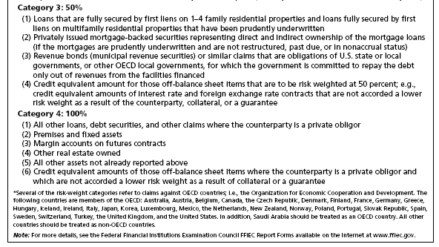

Slide 17
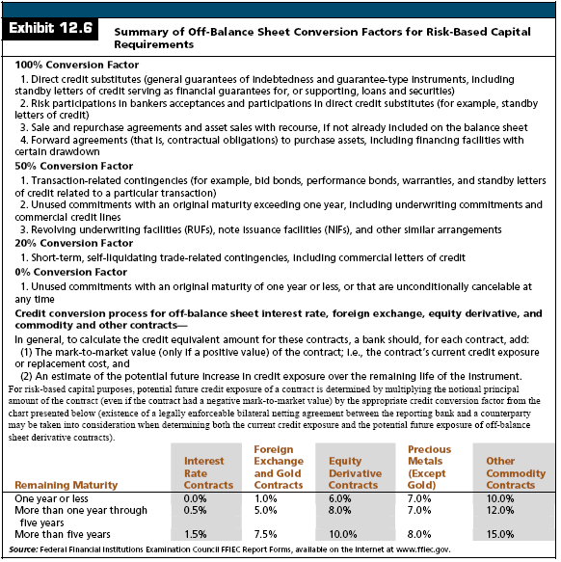

Slide 18
What Constitutes Bank Capital?
Capital (Net Worth)
  The cumulative value of assets minus the cumulative value of liabilities
  Represents ownership interest in a firm

Slide 19
What Constitutes Bank Capital?
Total Equity Capital
  Equals the sum of:
    Common stock
    Surplus
    Undivided profits and capital reserves
    Net unrealized holding gains (losses) on available-for-sale securities
    Preferred stock

Slide 20
What Constitutes Bank Capital?
Tier 1 (Core) Capital
  Equals the sum of:
    Common equity
    Non-cumulative perpetual preferred stock
    Minority interest in consolidated subsidiaries, less intangible assets such as goodwill

Slide 21
What Constitutes Bank Capital?
Tier 2 (Supplementary) Capital
  Equals the sum of:
    Cumulative perpetual preferred stock
    Long-term preferred stock
    Limited amounts of term-subordinated debt
    Limited amount of the allowance for loan loss reserves (up to 1.25 percent of risk-weighted assets)

Slide 22
What Constitutes Bank Capital?
Leverage Capital Ratio
  Tier 1 capital divided by total assets net of goodwill and disallowed intangible assets and deferred tax assets
    Regulators are concerned that a bank could acquire practically all low-risk assets such that risk-based capital requirements would be virtually zero
      To prevent this, regulators have also imposed a 3 percent leverage capital ratio

Slide 23
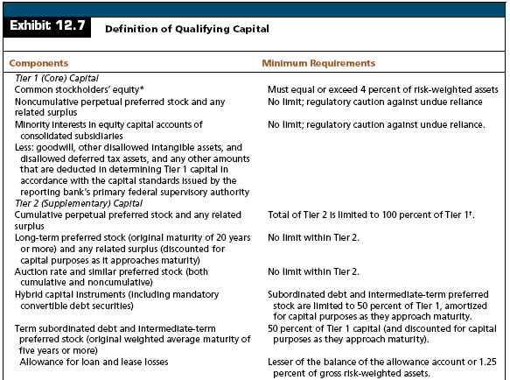

Slide 24

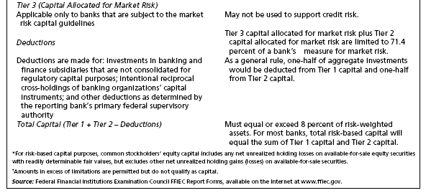
What Constitutes Bank Capital?

Slide 25
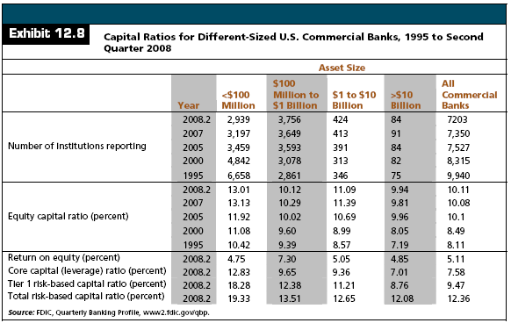
What Constitutes Bank Capital?

Slide 26
What Constitutes Bank Capital?
Tier 3 Capital Requirements for Market Risk Under Basel I
  Market Risk
    The risk of loss to the bank from fluctuations in interest rates, equity prices, foreign exchange rates, commodity prices, and exposure to specific risk associated with debt and equity positions in the bank’s trading portfolio

Slide 27
What Constitutes Bank Capital?
Tier 3 Capital Requirements for Market Risk Under Basel I
  Banks subject to the market risk capital guidelines must maintain an overall minimum 8 percent ratio of total qualifying capital [the sum of Tier 1 capital, Tier 2 capital, and Tier 3 capital allocated for market risk, net of all deductions] to risk-weighted assets and market risk–equivalent assets

Slide 28
What Constitutes Bank Capital?
Basel II Capital Standards
  Risk-based capital standards that encompass a three-pillar approach for determining the capital requirements for financial institutions
  Basel II capital standards are designed to produce minimum capital requirements that incorporate more types of risk than the credit risk-based standards of Basel I
    Basel II standards have not been finalized

Slide 29
What Constitutes Bank Capital?
Basel II Capital Standards
  Pillar I
    Credit risk
    Market risk
    Operational risk
  Pillar II
    Supervisory review of capital adequacy
  Pillar III
    Market discipline through enhanced public disclosure

Slide 30
What Constitutes Bank Capital?
Weaknesses of the Risk-Based Capital Standards
  Standards only consider credit risk
    Ignores interest rate risk and liquidity risk
  Core banks subject to the advanced approaches of Basel II use internal models to assess credit risk
    Results of their own models are reported to the regulators

Slide 31
What Constitutes Bank Capital?
Weaknesses of the Risk-Based Capital Standards
  The new risk-based capital rules of Basel II are heavily dependent on credit ratings, which have been extremely inaccurate in the recent past
  Book value of capital is often not meaningful since It ignores:
    changes in the market value of assets
    unrealized gains (losses) on held-to-maturity securities
  97% of banks are considered “well capitalized” in 2007
    Not a binding constraint for most banks

Slide 32
What is the Function of Bank Capital
For regulators, bank capital serves to protect the deposit insurance fund in case of bank failures
Bank capital reduces bank risk by:
  Providing a cushion for firms to absorb losses and remain solvent
  Providing ready access to financial markets, which provides the bank with liquidity
  Constraining growth and limits risk taking

Slide 33
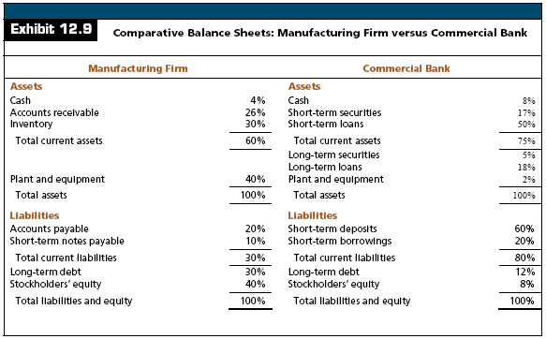
What is the Function of Bank Capital

Slide 34
How Much Capital Is Adequate?
Regulators prefer more capital
  Reduces the likelihood of bank failures and increases bank liquidity
Bankers prefer less capital
  Lower capital increases ROE, all other things the same
Riskier banks should hold more capital while lower-risk banks should be allowed to increase financial leverage

Slide 35
The Effect of Capital Requirements on Bank Operating Policies
Limiting Asset Growth
  The change in total bank assets is restricted by the amount of bank equity
    where
      TA = Total Assets
      EQ = Equity Capital
      ROA = Return on Assets
      DR = Dividend Payout Ratio
      EC = New External Capital

Slide 36
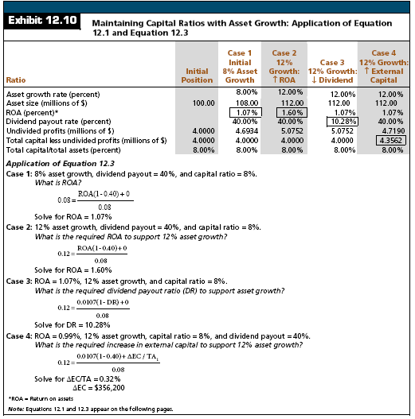

Slide 37
The Effect of Capital Requirements on Bank Operating Policies
Changing the Capital Mix
  Internal versus External capital
Change Asset Composition
  Hold fewer high-risk category assets
Pricing Policies
  Raise rates on higher-risk loans
Shrinking the Bank
  Fewer assets requires less capital

Slide 38
Characteristics of External Capital Sources
Subordinated Debt
  Advantages
    Interest payments are tax-deductible
    No dilution of ownership interest
    Generates additional profits for shareholders as long as earnings before interest and taxes exceed interest payments

Slide 39
Characteristics of External Capital Sources
Subordinated Debt
  Disadvantages
    Does not qualify as Tier 1 capital
    Interest and principal payments are mandatory
    Many issues require sinking funds

Slide 40
Characteristics of External Capital Sources
Common Stock
  Advantages
    Qualifies as Tier 1 capital
    It has no fixed maturity and thus represents a permanent source of funds
    Dividend payments are discretionary
    Losses can be charged against equity, not debt, so common stock better protects the FDIC

Slide 41
Characteristics of External Capital Sources
Common Stock
  Disadvantages
    Dividends are not tax-deductible,
    Transactions costs on new issues exceed comparable costs on debt
    Shareholders are sensitive to earnings dilution and possible loss of control in ownership
    Often not a viable alternative for smaller banks

Slide 42
Characteristics of External Capital Sources
Preferred Stock
  A form of equity in which investors' claims are senior to those of common stockholders
  Dividends are not tax-deductible
  Corporate investors in preferred stock pay taxes on only 20 percent of dividends
  Most issues take the form of adjustable-rate perpetual stock

Slide 43
Characteristics of External Capital Sources
Trust Preferred Stock
  A hybrid form of equity capital at banks
  It effectively pays dividends that are tax deductible
    To issue the security, a bank establishes a trust company
    The trust company sells preferred stock to investors and loans the proceeds of the issue to the bank
    Interest on the loan equals dividends paid on preferred stock
    The interest on the loan is tax deductible such that the bank deducts dividend payments
    Counts as Tier 1 capital

Slide 44
Characteristics of External Capital Sources
TARP Capital Purchase Program
  The Troubled Asset Relief Program’s Capital Purchase Program (TARP-CPP), allows financial institutions to sell preferred stock that qualifies as Tier 1 capital to the Treasury
    Qualified institutions may issue senior preferred stock equal to not less than 1% of risk-weighted assets and not more than the lesser of $25 billion, or 3%, of risk-weight assets

Slide 45
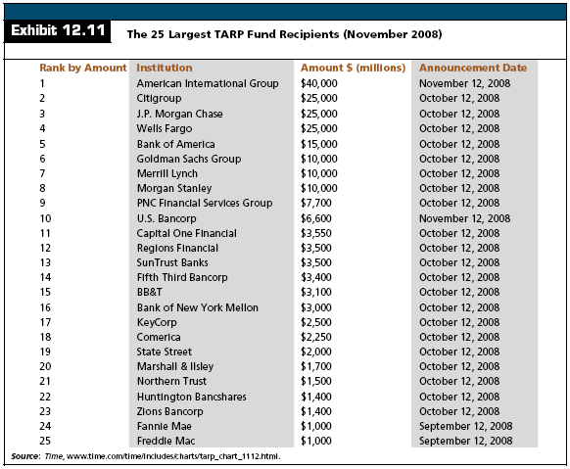

Slide 46
Characteristics of External Capital Sources
Leasing Arrangements
  Many banks enter into sale and leaseback arrangements
    Example:
      The bank sells its headquarters and simultaneously leases it back from the buyer
      The bank receives a large amount of cash and still maintains control of the property
      The net effect is that the bank takes a fully depreciated asset and turns it into a tax deduction

Slide 47
Capital Planning
Process of Capital Planning
  Generate pro formal balance sheet and income statements for the bank
  Select a dividend payout
  Analyze the costs and benefits of alternative sources of external capital

Slide 48
Capital Planning
Application
  Consider a bank that has exhibited a deteriorating profit trend
    Assume as well that federal regulators who recently examined the bank indicated that the bank should increase its primary capital-to-asset ratio to 8.5% within four years from its current 7%
    The $80 million bank reported an ROA of just 0.45 percent
    During each of the past five years, the bank paid $250,000 in common dividends

Slide 49
Capital Planning
Application
  Consider a bank that has exhibited a deteriorating profit trend
    The following slide extrapolates historical asset growth of 10%
      Under this scenario, the bank will actually see its capital ratio fall
    The following slide also identifies three different strategies for meting the required 8.5% capital ratio

Slide 50
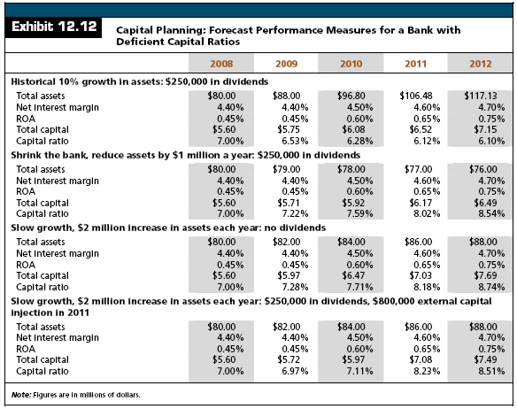

Slide 51
Depository Institutions Capital Standards
The Federal Deposit Insurance Improvement Act (FDICIA) focused on revising bank capital requirements to:
  Emphasize the importance of capital
  Authorize early regulatory intervention in problem institutions
  Authorized regulators to measure interest rate risk at banks and require additional capital when it is deemed excessive

Slide 52
Depository Institutions Capital Standards
The Act required a system for prompt regulatory action
  It divides banks into categories according to their capital positions and mandates action when capital minimums are not met

Slide 53
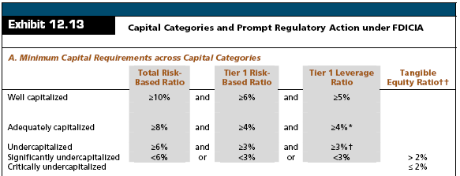
Depository Institutions Capital Standards

Slide 54

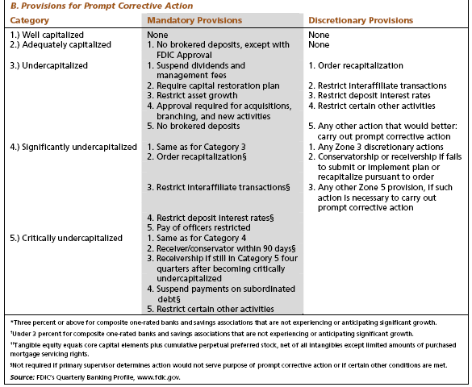

Slide 55
Federal Deposit Insurance
Federal Deposit Insurance Corporation
  Established in 1933
  Coverage is currently $100,000 per depositor per institution
    Original coverage was $2,500

Slide 56
Federal Deposit Insurance
Federal Deposit Insurance Corporation
  Initial Objective:
    Prevent liquidity crises caused by large-scale deposit withdrawals
    Protect depositors of modes means against a bank failure

Slide 57
Federal Deposit Insurance
Federal Deposit Insurance Corporation
  The Financial Institution Reform, Recovery and Enforcement Act of 1989 authorized the issuance of bonds to finance the bailout of the FSLIC
    The act also created two new insurance funds, the Savings Association Insurance Fund (SAIF) and the Bank Insurance Fund (BIF); both were controlled by the FDIC

Slide 58
Federal Deposit Insurance
Federal Deposit Insurance Corporation
  The large number of failures in the late 1980s and early 1990s depleted the FDIC fund
    During 1991 - 92, the FDIC ran a deficit and had to borrow from the Treasury
    In 1991 FDIC began charging risk-based deposit insurance premiums ranging from $0.23 to $0.27 per $100, depending on a bank’s capital position.
    By 1993, the reduction in bank failures and increased premiums allowed the FDIC to pay off the debt and put the fund back in the black

Slide 59
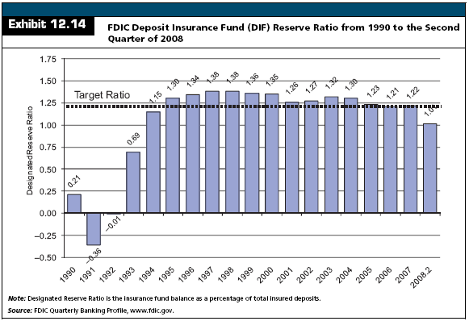
Federal Deposit Insurance

Slide 60
Federal Deposit Insurance
FDIC Insurance Assessment Rates
  FDIC insurance premiums are assessed using a risk-based deposit insurance system
  Deposit insurance assessment rates are reviewed semiannually by the FDIC to ensure that premiums appropriately reflect the risks posed to the insurance funds and that fund reserve ratios are maintained at or above the target designated reserve ratio (DRR) of 1.25% of insured deposits
  Deposit insurance premiums are assessed as basis points per $100 of insured deposits

Slide 61
Federal Deposit Insurance
FDIC Insurance Assessment Rates
  FDIC Improvement Act
    Merged the BIF and SAIF into the Deposit Insurance Fund (DIF)
    Increasing coverage for retirement accounts to $250,000 and indexing the coverage to inflation
    Established a range of 1.15% to 1.50% within which the FDIC Board of Directors may set the Designated Reserve Ratio (DRR)

Slide 62
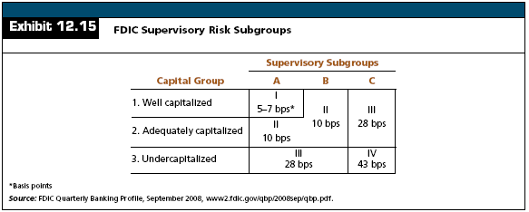
Federal Deposit Insurance
FDIC Insurance Assessment Rates

Slide 63
Federal Deposit Insurance
FDIC Insurance Assessment Rates
  Subgroup A
    Financially sound institutions with only a few minor weaknesses
    This subgroup assignment generally corresponds to the primary federal regulator’s composite rating of “1” or “2”

Slide 64
Federal Deposit Insurance
FDIC Insurance Assessment Rates
  Subgroup B
    Institutions that demonstrate weaknesses that, if not corrected, could result in significant deterioration of the institution and increased risk of loss to the BIF or SAIF
    This subgroup assignment generally corresponds to the primary federal regulator’s composite rating of “3”

Slide 65
Federal Deposit Insurance
FDIC Insurance Assessment Rates
  Subgroup C
    Institutions that pose a substantial probability of loss to the BIF or the SAIF unless effective corrective action is taken
    This subgroup assignment generally corresponds to the primary federal regulator’s composite rating of “4” or “5”

Slide 66
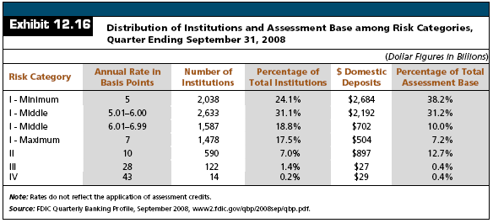
Federal Deposit Insurance
FDIC Insurance Assessment Rates

Slide 67
Federal Deposit Insurance
Problems With Deposit Insurance
  Deposit insurance acts similarly to bank capital
    In banking, a large portion of borrowed funds come from insured depositors who do not look to the bank’s capital position in the event of default
    A large number of depositors, therefore, do not require a risk premium to be paid by the bank since their funds are insured
    Normal market discipline in which higher risk requires the bank to pay a risk premium does not apply to insured funds

Slide 68
Federal Deposit Insurance
Problems With Deposit Insurance
  Too-Big-To-Fail
    Many large banks are considered to be “too-big-to-fail”
    As such, any creditor of a large bank would receive de facto 100 percent insurance coverage regardless of the size or type of liability

Slide 69
Federal Deposit Insurance
Problems With Deposit Insurance
  Deposit insurance has historically ignored the riskiness of a bank’s operations, which represents the critical factor that leads to failure
    Two banks with equal amounts of domestic deposits paid the same insurance premium, even though one invested heavily in risky loans and had no uninsured deposits while the other owned only U.S. government securities and just 50 percent of its deposits were fully insured
    The creates a moral hazard problem

Slide 70
Federal Deposit Insurance
Problems With Deposit Insurance
  Moral Hazard
    A lack of incentives that would encourage individuals to protect or mitigate against risk
      In some cases of moral hazard, incentives are created that would actually increase risk-taking behavior

Slide 71
Federal Deposit Insurance
Problems With Deposit Insurance
  Deposit insurance funds were always viewed as providing basic insurance coverage
    Historically, there has been fundamental problem with the pricing of deposit insurance
      Premium levels were not sufficient to cover potential payouts

Slide 72
Federal Deposit Insurance
Problems With Deposit Insurance
  Historically, premiums were not assessed against all of a bank’s insured liabilities
    Insured deposits consisted only of domestic deposits while foreign deposits were exempt
    Too-big-to-fail doctrine toward large banks means that large banks would have coverage on 100 percent of their deposits but pay for the same coverage as if they only had the same $250,000 coverage as smaller banks do

Slide 73
Federal Deposit Insurance
Weakness of the Current Risk-Based Deposit Insurance System
  Risk-based deposit system is based on capital and risk
    Hence, banks that hold higher capital, everything else being equal, pay lower premiums
  “Too Big to Fail”
    The FDIC must follow the “least cost” alternative in the resolution of a failed bank. Consequently, the FDIC must consider all alternatives and choose the one that represents the lowest cost to the insurance fund

Slide 74
The Effective Use of Capital

