Slide 1
Managing Non-Interest Income & Non-Interest Expense

Slide 2
Issues in Interest Income & Interest Expense
Deregulation in the 1990s lead to an increase in competition and a decrease in NIM.
NIM is inversely related to bank size.

Slide 3
Issues in Interest Income and Interest Expense
Core deposit growth has slowed
Disintermediation
Relative loan yields have fallen
Increased competition for loans
Refinance “option”
Government intervention
The result is lower NIM
Banks must increase non-interest income (relative to non-interest expense) to grow profits

Slide 4
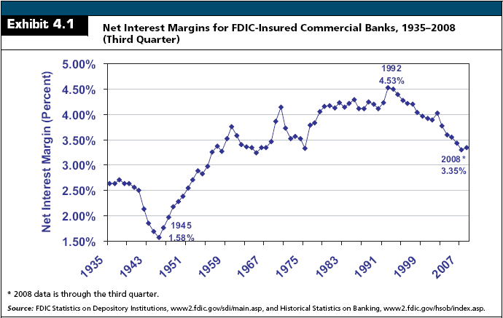

Slide 5
Non-Interest Income
Sources of Non-Interest Income
Fiduciary Activities
Deposit Service Charges
Trading Revenue
Investment Banking/Brokerage Activities
Insurance Commissions
Net Servicing Fees
Net Gains/Losses on Loan Sales
Other Net Gains/Losses and Other Non-Interest Income

Slide 6
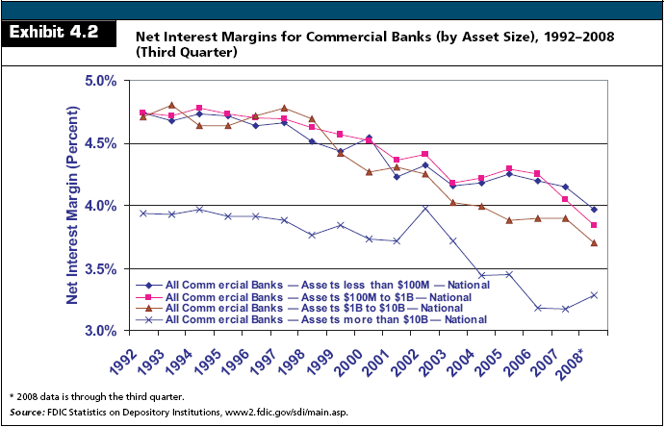

Slide 7
Non-Interest Income
All fees are NOT created equal
Some fees are stable and predictable over time, while others are highly volatile because they are cyclical
Non-Interest Income has increased as a proportion of net operating revenue
Largest contributors are deposit service charges and other non-interest income
Larger banks rely more on non-interest income than their smaller counterparts

Slide 8
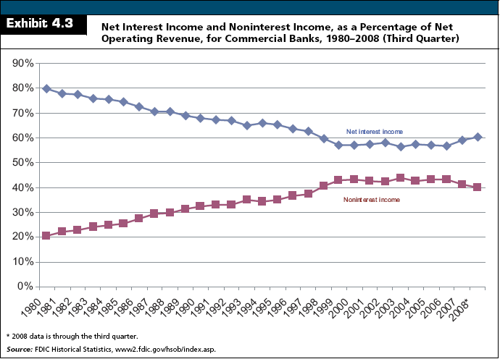

Slide 9
Non-Interest Income
Deposit Service Fees
Stable source of revenue
Relatively price inelastic
Large banks tend to charge more for these services than small banks
Notes:
NSF and Overdraft fees are relatively inelastic

Slide 10
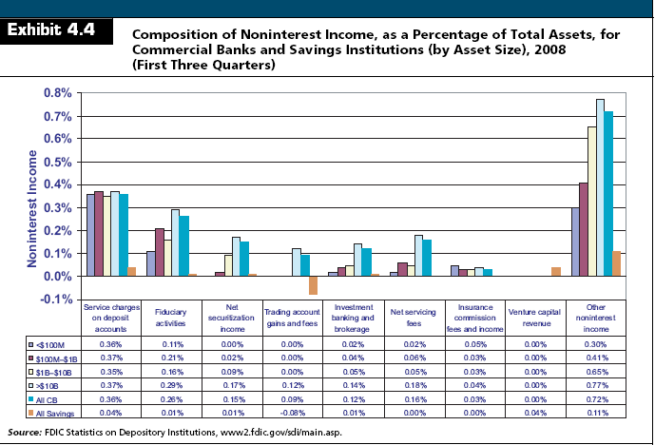

Slide 11
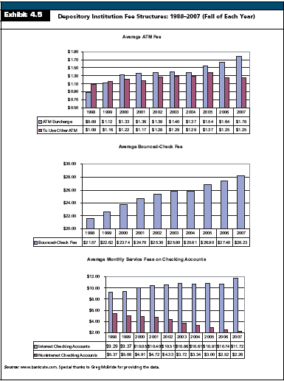

Slide 12
Non-Interest Expense
Personnel Expense
Occupancy Expense
Goodwill Impairment
Other Intangible Amortization
Other Operating Expense

Slide 13
Non-Interest Expense
Key Ratios
Burden (Net Overhead Expense)
Burden = Non-Interest Expense – Non-Interest Income
Lower is better
Net Non-Interest Margin
Net Non-Interest Margin = Burden/Average Total Assets
Lower is better

Slide 14
Non-Interest Expense
Key Ratios
Efficiency Ratio
Larger banks tend to have lower (better) efficiency ratios because they generate more non-interest income
Low efficiency ratios do not always lead to higher ROEs

Slide 15
Non-Interest Expense
Key Ratios
Efficiency Ratio

Slide 16
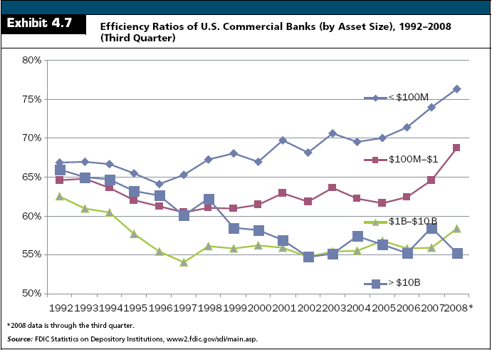

Slide 17
Non-Interest Expense
Key Ratios
Operating Risk Ratio
Lower is better because proportionally more income comes from fees

Slide 18
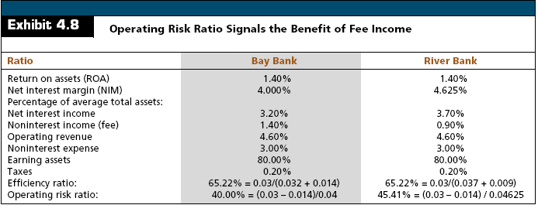
Non-Interest Expense
Key Ratios
Operating Risk Ratio

Slide 19
Non-Interest Expense
Key Ratios
Productivity Ratios
Assets per Employee
Average Personnel Expense
Can be biased on the high side due to senior management compensation

Slide 20
Non-Interest Expense
Key Ratios
Productivity Ratios
Dollar Amount of Loans Per Employee
Net Income Per Employee

Slide 21
Non-Interest Expense
Key Ratios
Productivity Ratios

Slide 22
Which Lines of Business and Customers are Profitable?
Line-of-Business Profitability Analysis
Risk-Adjusted Return on Capital
Return on Risk-Adjusted Capital

Slide 23
Which Lines of Business and Customers are Profitable?
Customer Profitability Analysis
Analyses of customer profitability profiles suggest that banks make most of their profit from a relatively small fraction of customers
View is that 20% of a bank’s customers account for 80% of profits

Slide 24
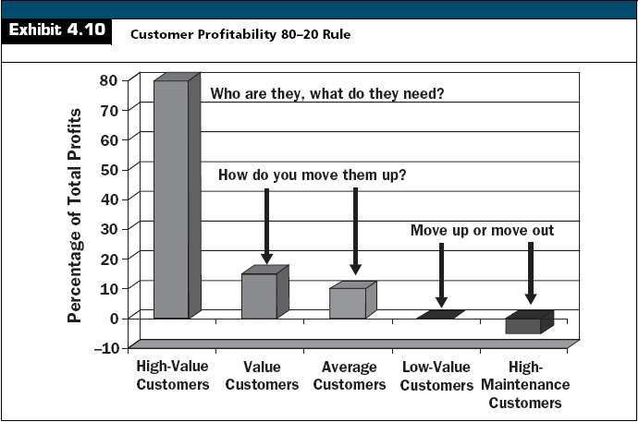

Slide 25
Which Lines of Business and Customers are Profitable?
Customer Profitability Analysis
Expense Components
Non-Credit Services
Check-processing expenses are the major non-credit cost item for commercial customers
Credit Services
Cost of Funds
Loan Administration Expense

Slide 26
Which Lines of Business and Customers are Profitable?
Customer Profitability Analysis
Expense Components
Transaction Risk
Risk of fraud, theft, error, and delays in processing, clearing, and settling payments
Default Risk
Single largest risk
Business Risk Expense
Losses and allocations for potential losses

Slide 27
Which Lines of Business and Customers are Profitable?
Customer Profitability Analysis
Revenue Components
Investment Income from Deposit Balances
Earnings Credit
Non-Interest Income
Fee Income
Loan Interest

Slide 28
Which Lines of Business and Customers are Profitable?
Aggregate Profitability Results From Customer Profitability Analysis
Profitable customers maintain multiple relationships with the bank
Unprofitable customers tend to “shop” for the lowest price and do not use multiple products

Slide 29
Which Lines of Business and Customers are Profitable?
What Is The Appropriate Business Mix?
Some fee income comes from relatively stable services and lines of business, while other fees are highly volatile.
One problem is that some managers view these volatile fees as permanent sources of income.
Community banks do not have the same opportunities to enter investment banking and specialty intermediation.

Slide 30
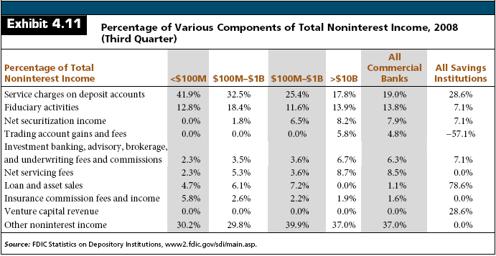
Which Lines of Business and Customers are Profitable?
What Is The Appropriate Business Mix?

Slide 31
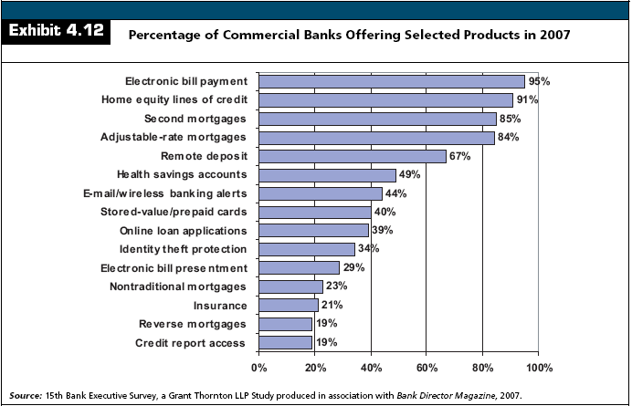

Slide 32
Which Lines of Business and Customers are Profitable?
Cost Management Strategies
Expense Reduction
Outsourcing
Operating Efficiencies
Reduce costs but maintaining the existing level of products and services
Increase the level of output but maintaining the level of current expenses
Improve workflow

Slide 33
Which Lines of Business and Customers are Profitable?
Cost Management Strategies
Operating Efficiencies
Economies of Scale
Economies of Scope

Slide 34
Which Lines of Business and Customers are Profitable?
Revenue Enhancement
Contribution Growth
Allocates resources to best improve overall long-term profitability
Increases in expenses are acceptable and expected, but must coincide with greater anticipated increases in associated revenues.

Slide 35
The Performance of Nontraditional Banking Companies

Slide 36
The Performance of Nontraditional Banking Companies
Examine:
Goldman Sachs
Investment bank converted to financial holding company in 2008
Mutual of Omaha Bank
Subsidiary of Mutual of Omaha
BMW Bank of North America
An industrial loan corporation (ILC) owned by BMW Financial Services, a division of BMW North America

Slide 37
The Performance of Nontraditional Banking Companies
Financial Services Modernization Act (1999)
Effectively allowed commercial and investment banks to merge.
Investment Banking Activities
Securities underwriting
Advisory services
Market making
Propriety trading and investing

Slide 38
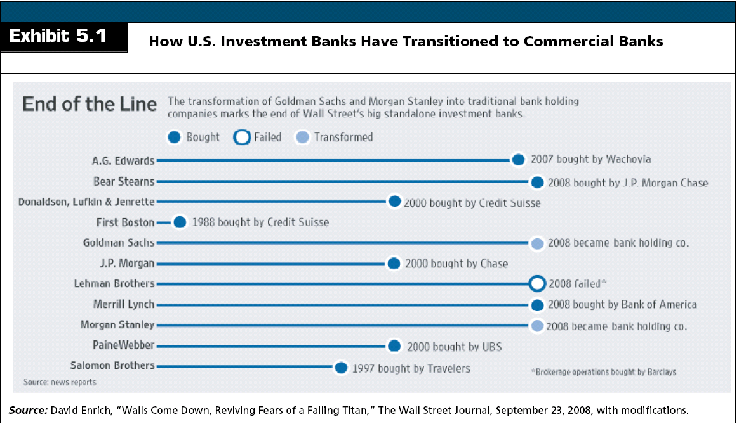
The Performance of Nontraditional Banking Companies

Slide 39
The Financial Performance of Goldman Sachs
Securities Underwriting
Investment banks assist in raising funds through the issuance of bonds or stocks. If the security offering is a first-time placement
Initial Public Offering (IPO)
First-time placement

Slide 40
The Financial Performance of Goldman Sachs
Advisory Services
Investment banks offer numerous fee-based services that assist in managing risks
Primary services are:
Providing advice concerning mergers and acquisitions and spin-offs of lines of business
Managing investable assets
Making risk management decisions involving the uses of foreign currencies, commodities, and derivatives

Slide 41
The Financial Performance of Goldman Sachs
Market Making
Investment banks may stand willing to buy securities from participants who want to sell and to sell securities to participants who want to buy
Profit from the bid-ask spread.
May also make a profit from the difference between the yield on the securities owned and the interest paid on debt
Acts as a broker and does not take ownership of the underlying security.

Slide 42
The Financial Performance of Goldman Sachs
Proprietary Trading and Principal Investing
Principal Investing
When an investment bank takes a position in a security, derivative or stock of a company with the expectation that it will hold the position for some time, possibly even years, before trading out of it

Slide 43
The Financial Performance of Goldman Sachs
Proprietary Trading and Principal Investing
Principal Investing
Hedge Fund
An investment fund that is limited to a small number of sophisticated investors.
The fund’s managers take positions that are of any type and not subject to regulation.
Managers generally charge a 2 percent fee applied to the amount of assets under management plus a 20 percent performance fee equal to 20 percent of the profit generated during a year.
This 2 + 20 fee structure generates an extraordinary profit for the managers with limited downside risk.

Slide 44
The Financial Performance of Goldman Sachs
Proprietary Trading and Principal Investing
Principal Investing
Private Equity Fund
Accept investments from institutional investors in the form of limited partnership investments
The funds use the proceeds to buy companies and make other investments, but usually have a longer investment horizon than hedge funds when entering transactions.
Fund managers earn a management fee plus a percentage (usually 20 percent) of profits in excess of some minimum rate of return.

Slide 45
The Financial Performance of Goldman Sachs
How Did Goldman Sachs Perform in 2007?
Goldman Sachs’ Income Statement
Record profits
EPS over $26
ROE of nearly 33%

Slide 46
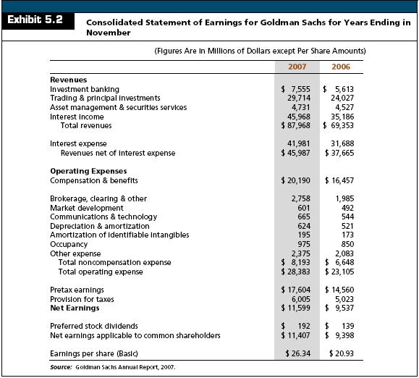

Slide 47
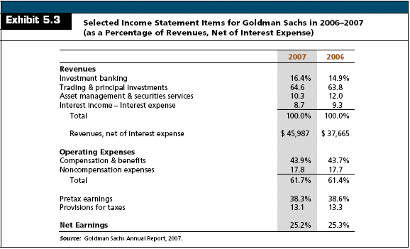
The Financial Performance of Goldman Sachs

Slide 48
The Financial Performance of Goldman Sachs
How Did Goldman Sachs Perform in 2007?
Goldman Sachs’ Balance Sheet
Financial Instruments Owned
Cash and derivative securities
Collateralized Agreements
Borrowed securities and other financial instruments purchased under an agreement to resell at a later date.
Receivables
Amounts owed to Goldman Sachs by brokers, the firm’s customers, and counterparties to derivative and other contracts.
Payables
Amounts owed by Goldman Sachs

Slide 49
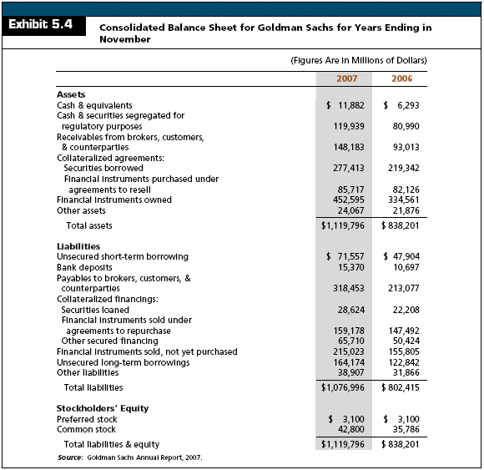

Slide 50
The Financial Performance of Goldman Sachs
How Did Goldman Sachs Perform in 2007?
Key Performance Ratios
Although Goldman Sachs did well in 2007, events in 2008 demonstrated that Goldman’s business model was not sustainable
Goldman Sachs faced a severe liquidity crisis in 2008 due to the collapse of the housing market and declines in the values of assets that Goldman owned
Its stock price fell from over $240 per share in 2007 to under $70 in 2008
In its fourth quarter of 2008, Goldman reported its first quarterly loss since it began trading as a public company

Slide 51
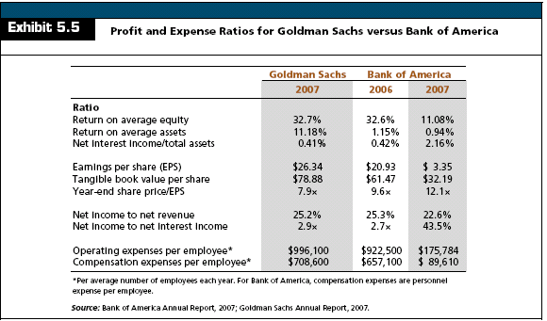
The Financial Performance of Goldman Sachs

Slide 52
The Financial Performance of Goldman Sachs
How Did Goldman Sachs Perform in 2007?
Risk Faced by Goldman Sachs
With the credit crisis of 2007–2009, the money and capital markets stopped functioning in any normal sense
The commercial paper market froze and large institutions were hesitant to lend to each other
Lenders were hesitant to roll over their debts and Goldman was unable to sell a sufficient volume of assets to readily access cash
Management thus decided to convert to a FHC, which would allow it to access more stable, core deposits for its funding
On the negative side, Goldman agreed to be regulated by the Federal Reserve as a bank

Slide 53
The Financial Performance of Goldman Sachs
How Did Goldman Sachs Perform in 2007?
Goldman’s Risk Profile in 2007
Increasing and/or high rates and widening credit spreads
Market fluctuations that may adversely affect the value of large trading and investment positions
Declines in the number and size of securities underwritings and mergers and acquisitions that may lower revenues
Declines in equity values that may lower asset management fees
Possible decline in the volume of transactions executed by the firm as a specialist or market maker
An increase in market volatility that may cause the firm to reduce its proprietary trading

Slide 54
The Financial Performance of Goldman Sachs
How Did Goldman Sachs Perform in 2007?
Goldman’s Risk Profile
Each of the above factors appeared to be to the detriment of Goldman Sachs in 2008
Goldman holds in its portfolio many different types of securities, some of which are difficult to value. Under FASB 157, Goldman Sachs is required to classify assets as Level 1, Level 2, or Level 3

Slide 55
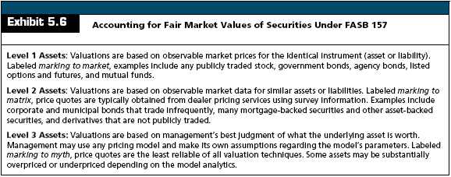
The Financial Performance of Goldman Sachs
How Did Goldman Sachs Perform in 2007?
Goldman’s Risk Profile

Slide 56
The Financial Performance of Mutual of Omaha Bank
Mutual of Omaha (MO)
An insurance company that offers a wide range of life, disability, long-term care, and medical supplement insurance along with annuities and mutual funds
In 2007, the company opened Mutual of Omaha Bank (MOB), a thrift with 13 locations in Nebraska and Colorado through the acquisition and merger of three existing banks
MOB’s strategic objective is to “acquire community banks in fast-growing cities with a high density of Mutual of Omaha insurance customers”

Slide 57
The Financial Performance of Mutual of Omaha Bank
Mutual of Omaha
In 2007, Mutual of Omaha had almost $20 billion in assets.
Business model is to combine insurance and banking activities under the holding company

Slide 58
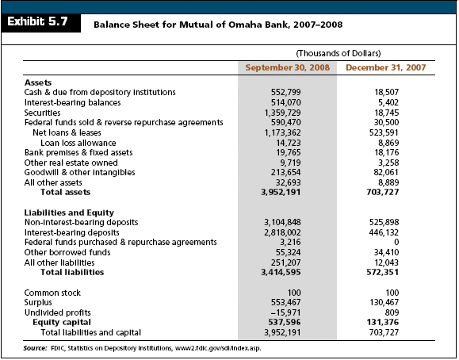

Slide 59
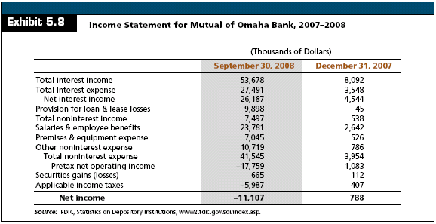

Slide 60
The Financial Performance of Mutual of Omaha Bank
Mutual of Omaha Bank’s Risk Profile
MOB faces the same types of risk that other commercial banks face
Its primary exposure is to credit risk
The principal benefit from operating as part of MO is the diversification benefit and access to capital

Slide 61
The Financial Performance of BMW Financial Services and BMW Bank of North America
Industrial Loan Companies (ILCs)
Originated in the early 1900s to make loans to borrowers who could not get loans at commercial banks
Over time, ILCs were granted the right to issue deposits that were insured by the FDIC
Today, the majority of ILCs are based in Utah, California, Colorado, and Nevada

Slide 62
The Financial Performance of BMW Financial Services and BMW Bank of North America
Industrial Loan Companies
Historically, most ILCs operated to assist their parent organization in some facet of the firm’s core business
ILCs gained notoriety when Wal-Mart applied for an ILC charter in 2005
Many community banks argued against granting Wal-Mart a charter because they were concerned that Wal-Mart would offer traditional banking services in all stores and potentially drive them out of business

Slide 63
The Financial Performance of BMW Financial Services and BMW Bank of North America
Industrial Loan Companies
The primary criticisms against granting commerce companies ILC charters are:
There should be a separation between commerce and banking to protect customers from potential conflicts of interest
Firms like Wal-Mart could become so large and powerful that they might dominant business in many communities
ILCs are not subject to the same regulation as commercial banks—which may create safety and soundness problems

Slide 64
The Financial Performance of BMW Financial Services and BMW Bank of North America
BMW Bank of North America is an ILC owned by BMW Financial Services
BMW Financial Services offers loans, leases, and credit cards via BMW Bank
Although BMW Bank operates from a single office in Utah, it collects deposits and uses borrowed funds to underwrite loans and leases for the purchase of automobiles at BMW dealers

Slide 65
The Financial Performance of BMW Financial Services and BMW Bank of North America
BMW Bank is chartered by the state of Utah and is also regulated by the FDIC because its deposits are FDIC insured
BMW Bank makes loans to individuals either in the form of credit card loans or loans for automobiles
The bank obtains most of it financing in the form of small time deposits and federal funds purchased

Slide 66
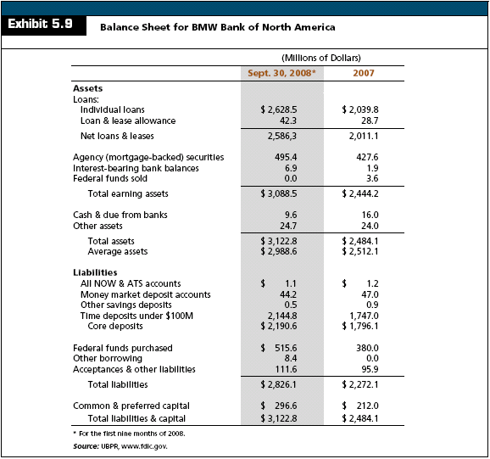

Slide 67
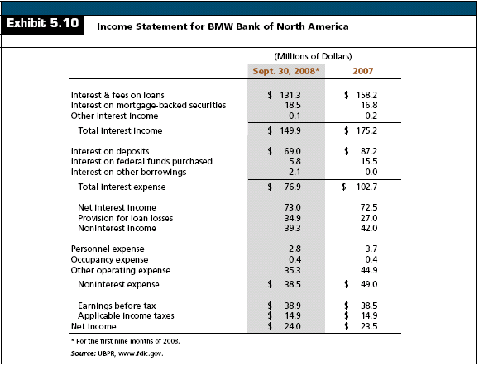

Slide 68
The Financial Performance of BMW Financial Services and BMW Bank of North America
BMW Bank’s Risk Profile
Reported higher ROE then peers
Invested proportionately more in loans than peers
Gets no funding from demand deposits, raising its cost of funds
Efficiency ratio is significantly lower than peers
Higher charge-offs than peers

Slide 69
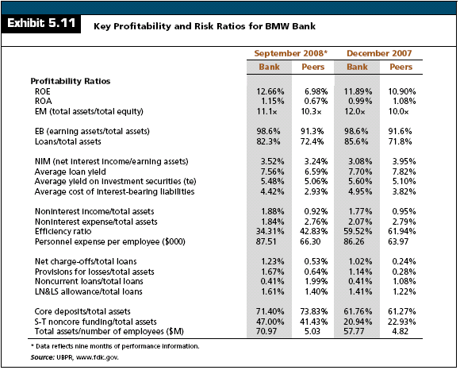

Slide 70
Pricing Fixed-Income Securities

Slide 71
The Mathematics of Interest Rates
Terms
Present Value = PV
The value today of a single future cash flow or series of cash flows
Future Value = FV
The amount to which a single cash flow or series of cash flows will grow over a given period of time when compounded at a given interest rate

Slide 72
The Mathematics of Interest Rates
Terms
Interest Rate Per Year = i
Number of Periods = n

Slide 73
Future Value and Present Value: Single Payment
Suppose you invest $1,000 for one year at 5% per year. What is the future value in one year?
PV(1+i) = FV1
$1,000(1.05) = $1,050

Slide 74
Future Value and Present Value: Single Payment
Suppose you leave the money in for another year. How much will you have two years from now?
PV(1+i)2 = FV2
$1,000(1.05)2 = $1,102.50

Slide 75
The Mathematics of Interest Rates
What is the future value of $1000 at 5% interest per year for two years?
Inputs:
N = 2
i = 5
PV = 1000
Output:
FV = -1102.50

Slide 76
Future Value and Present Value: Single Payment
Solving for the Rate of Interest
PV(1+i)^{n} = FV_{n}
i = (FV_{n}/PV)^{1/n} -1

Slide 77
Future Value and Present Value: Single Payment
Solving for the Rate of Interest
Suppose we invest in a CD that promises to double our money in 8 years. What is the annual interest rate?
i = ($1,800/$1,000)^{1/8} -1 = .0762 = 7.62%

Slide 78
Future Value and Present Value: Single Payment
Solving for Present Value
PV(1+i)^{n} = FV_{n} PV = FV_{n}/(1+i)^{n}

Slide 79
Future Value and Present Value: Single Payment
Solving for Present Value
Suppose you have a choice between receiving a cash payment of $50,000 today or $60,000 in three years. If you could earn 7% on your investments, which would you choose?
PV = $60,000/(1+.07)³ = $48,978

Slide 80
Future Value and Present Value: Single Payment
Solving for Present Value
Since $48,978 is less than $50,000, you would prefer the $50,000 today

Slide 81
Future Value and Present Value: Multiple Payments
Future Value
What is the future value of the following cash flow stream at the end of year 3?

Slide 82
Future Value and Present Value: Multiple Payments
Future Value
What is the future value of the following cash flow stream at the end of year 3?

Slide 83
Future Value and Present Value: Multiple Payments
Future Value
Find the value of each cash flow at the end of Year 3 and add them together
Cash Flow 0: FV = 7,000(1.08)³ = 8,817.98
Cash Flow 1: FV = 4,000(1.08)² = 4,665.60
Cash Flow 2: FV = 4,000(1.08) = 4,320
Cash Flow 3: FV = 4,000
Total value in 3 years
8,817.98 + 4,665.60 + 4,320 + 4,000 = 21,803.58

Slide 84
Future Value and Present Value: Multiple Payments
Present Value
What is the present value of the following cash flow stream?

Slide 85
Future Value and Present Value: Multiple Payments
Present Value
What is the present value of the following cash flow stream?

Slide 86
Future Value and Present Value: Multiple Payments
Present Value
Find the value of each cash flow today and add them together.
Cash Flow 1: FV = 200/(1.12) = 178.57
Cash Flow 2: FV = 400/(1.12)² = 318.88
Cash Flow 3: FV = 600(1.12)³ = 427.07
Cash Flow 4: FV = 800/(1.12)⁴ = 508.41
Total value
178.57 + 318.88 + 427.07 + 508.41 = 1,432.93

Slide 87
Simple versus Compound Interest
Compound Interest
Interest on Interest
Simple Interest
No Interest on Interest

Slide 88
Simple versus Compound Interest
Suppose is $1,000 deposited today at 5% for 2 years
FV with Simple Interest
$1,000 + $50 + $50 = $1,100
FV with Compound Interest
$1000(1.05)² = $1,102.50
The extra $2.50 comes from the extra interest earned on the first $50 interest payment
5%* $50 = $2.50.

Slide 89
Simple versus Compound Interest
Compounding Frequency
Compounding Frequency
i = Nominal Interest Rate
i* = Effective Annual Interest Rate
m = Number of Compounding Periods in a Year

Slide 90
Simple versus Compound Interest
Compounding Frequency
Suppose you can earn 1% per month on $100 invested today. How much are you effectively earning?
i* = (1 + .12/12)12 – 1
i* = (1.01)12 – 1 = .1268 = 12.68%

Slide 91
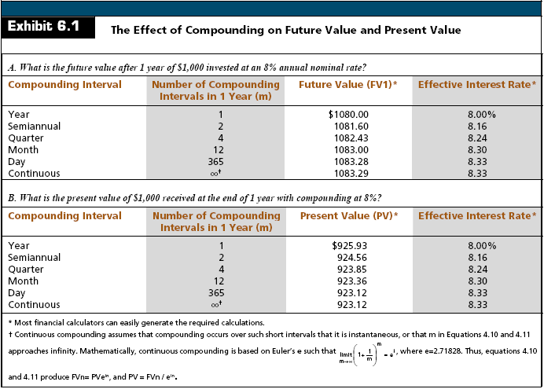

Slide 92
The Relationship Between Interest Rates and Option-Free Bond Prices
Bond Prices
A bond’s price is the present value of the future coupon payments (CPN) plus the present value of the face (par) value (FV)

Slide 93
The Relationship Between Interest Rates and Option-Free Bond Prices
Bond Prices and Interest Rates are Inversely Related
Consider a bond which pays semi-annual interest payments of $375 with a maturity of 3 years
If the market rate of interest is 7.50%, the price of the bond is:

Slide 94
The Relationship Between Interest Rates and Option-Free Bond Prices
Bond Prices and Interest Rates are Inversely Related
If the market rates of interest increases to 10%, the price of the bond falls to:

Slide 95
The Relationship Between Interest Rates and Option-Free Bond Prices
Bond Prices and Interest Rates are Inversely Related
If the market rates of interest decreases to 5%, the price of the bond rises to:

Slide 96
The Relationship Between Interest Rates and Option-Free Bond Prices
Bond Prices and Interest Rates are Inversely Related
Par Bond
Yield to maturity = coupon rate
Discount Bond
Yield to maturity > coupon rate
Premium Bond
Yield to maturity < coupon rate
Notes:
Point out that the APR is the same in either case, but your effective rate is different. Ask them which account they should use.

Slide 97
The Relationship Between Interest Rates and Option-Free Bond Prices
Notes:
Point out that the APR is the same in either case, but your effective rate is different. Ask them which account they should use.

Slide 98
The Relationship Between Interest Rates and Option-Free Bond Prices
Bond Prices Change Asymmetrically to Rising and Falling Rates
For a given absolute change in interest rates, the percentage increase in an option-free bond’s price will exceed the percentage decrease
Notes:
Point out that the APR is the same in either case, but your effective rate is different. Ask them which account they should use.

Slide 99
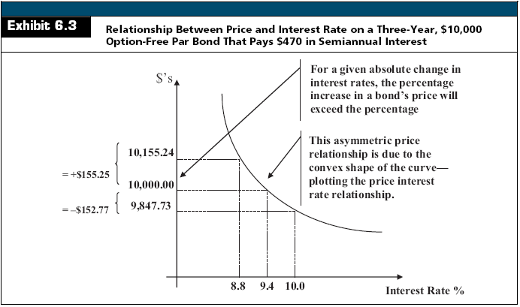

Slide 100
The Relationship Between Interest Rates and Option-Free Bond Prices
Maturity Influences Bond Price Sensitivity
For bonds that pay the same coupon rate, long-term bonds change proportionally more in price than do short-term bonds for a given rate change
Notes:
Point out that the APR is the same in either case, but your effective rate is different. Ask them which account they should use.

Slide 101
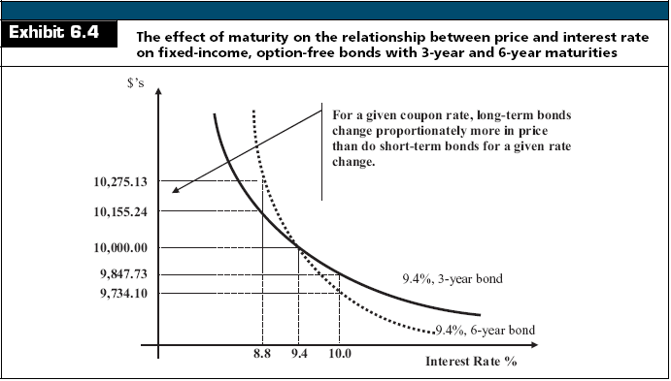

Slide 102
The Relationship Between Interest Rates and Option-Free Bond Prices
The Size of the Coupon Influences Bond Price Sensitivity
For bonds that have the same maturity, long-term bonds will change proportionally more in price than short-term bonds for a given change in the rate change
Notes:
Point out that the APR is the same in either case, but your effective rate is different. Ask them which account they should use.

Slide 103
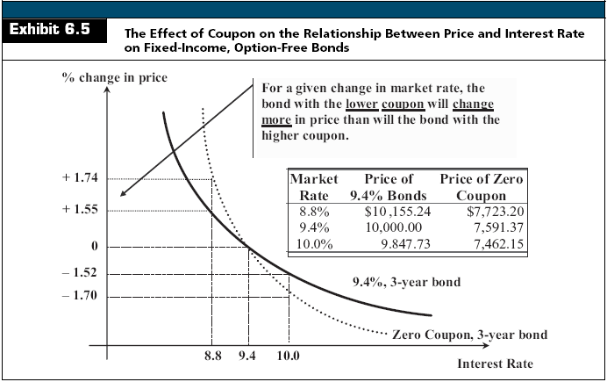

Slide 104
Duration and Price Volatility
Duration as an Elasticity Measure
Maturity simply identifies how much time elapses until final payment
It ignores all information about the timing and magnitude of interim payments

Slide 105
Duration and Price Volatility
Duration as an Elasticity Measure
Duration is a measure of the effective maturity of a security
Duration incorporates the timing and size of a security’s cash flows
Duration measures how price sensitive a security is to changes in interest rates
The greater (shorter) the duration, the greater (lesser) the price sensitivity

Slide 106
Duration and Price Volatility
Duration as an Elasticity Measure
Duration versus Maturity
Consider the cash flows for these two securities

Slide 107
Duration and Price Volatility
Duration as an Elasticity Measure
Duration versus Maturity
The maturity of both is 20 years
Maturity does not account for the differences in the timing of the cash flows

Slide 108
Duration and Price Volatility
Duration as an Elasticity Measure
Duration versus Maturity
What is the effective maturity of both?
The effective maturity of the first security is: (1,000/1,000) x 1 = 20 years
The effective maturity of the second security is:
[(900/1,000) x 1]+[(100/1,000) x 20] = 2.9 years
Duration is similar, however, it uses a weighted average of the present values of the cash flows

Slide 109
Duration and Price Volatility
Duration as an Elasticity Measure
Duration is an approximate measure of the price elasticity of demand

Slide 110
Duration and Price Volatility
Duration as an Elasticity Measure
The longer the duration, the larger the change in price for a given change in interest rates

Slide 111
Duration and Price Volatility
Measuring Duration
Duration is a weighted average of the time until the expected cash flows from a security will be received, relative to the security’s price
Macaulay’s Duration

Slide 112
Duration and Price Volatility
Measuring Duration
Example
What is the duration of a bond with a $1,000 face value, 10% coupon, 3 years to maturity and a 12% YTM?

Slide 113
Duration and Price Volatility
Measuring Duration
Example
What is the duration of a bond with a $1,000 face value, 10% coupon, 3 years to maturity but the YTM is 5%?

Slide 114
Duration and Price Volatility
Measuring Duration
Example
What is the duration of a bond with a $1,000 face value, 10% coupon, 3 years to maturity but the YTM is 20%?

Slide 115
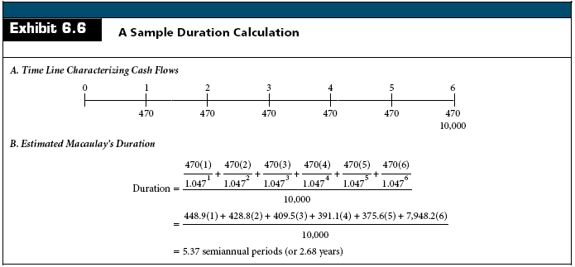
Duration and Price Volatility

Slide 116
Duration and Price Volatility
Duration of a Zero Coupon Bond
What is the duration of a zero coupon bond with a $1,000 face value, 3 years to maturity but the YTM is 12%?
By definition, the duration of a zero coupon bond is equal to its maturity

Slide 117
Duration and Price Volatility
Comparing Price Sensitivity
The greater the duration, the greater the price sensitivity

Slide 118
Duration and Price Volatility
Comparing Price Sensitivity
With Modified Duration, we have an estimate of price volatility:

Slide 119
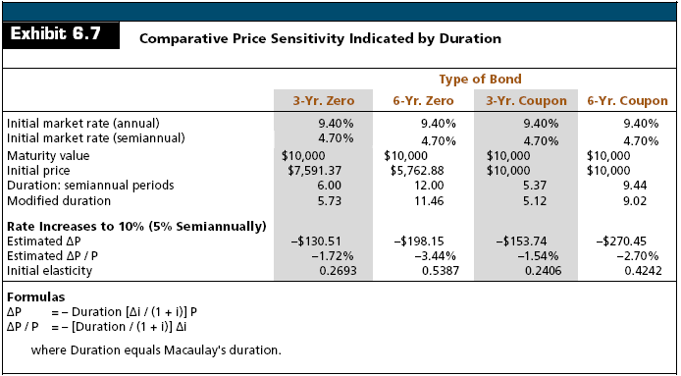

Slide 120
Recent Innovations in the Valuation of Fixed-Income Securities
Traditional fixed-income valuation methods are too simplistic because:
Investors often do not hold securities until maturity
Present value calculations assume all coupon payments are reinvested at the calculated Yield to Maturity
Many securities carry embedded options, such as a call or put, which complicates valuation since it is unknown if the option will be exercised and at what price

Slide 121
Recent Innovations in the Valuation of Fixed-Income Securities
Fixed-Income securities should be priced as a package of cash flows with each cash flow discounted at the appropriate zero coupon rate

Slide 122
Recent Innovations in the Valuation of Fixed-Income Securities
Total Return Analysis
Sources of Return
Coupon Interest
Reinvestment Income
Interest-on-interest
Capital Gains or Losses

Slide 123
Recent Innovations in the Valuation of Fixed-Income Securities
Total Return Analysis
Example
What is the total return for a 9-year, 7.3% coupon bond purchased at $99.62 per $100 par value and held for 5-years?
Assume the semi-annual reinvestment rate is 3% and after five years a comparable 4-year maturity bond will be priced to yield 7% (3.5% semi-annually) to maturity

Slide 124
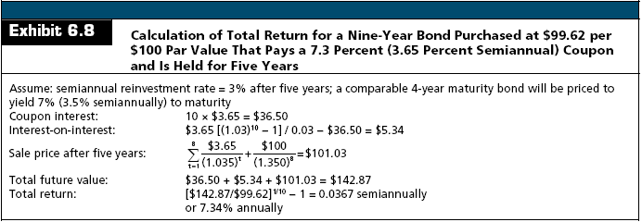
Recent Innovations in the Valuation of Fixed-Income Securities
Total Return Analysis

Slide 125
Money Market Yields
Interest-Bearing Loans with Maturities of One Year or Less
The effective annual yield for a loan less than one year is:

Slide 126
Money Market Yields
Interest rates on different money market instruments are measured and quoted in different terms
Some money market instruments are quoted on a discount basis, while others bear interest
Some yields are quoted on a 360-day year rather than a 365 or 366 day year

Slide 127
Money Market Yields
Interest-Bearing Loans with Maturities of One Year or Less
Assume a 180 day loan is made at an annualized rate of 10%. What is the effective annual yield?

Slide 128
Money Market Yields
360-Day versus 365-Day Yields
Some securities are reported using a 360 year rather than a full 365 day year
This will mean that the rate quoted will be 5 days too small on a standard annualized basis of 365 days

Slide 129
Money Market Yields
360-Day versus 365-Day Yields
To convert from a 360-day year to a 365-day year:
i₃₆₅ = i₃₆₀ (365/360)
Example
One year instrument at an 8% nominal rate on a 360-day year is actually an 8.11% rate on a 365-day year:
i₃₆₅ = 0.08 (365/360) = 0.0811

Slide 130
Money Market Yields
Discount Yields
Some money market instruments, such as Treasury Bills, are quoted on a discount basis
This means that the purchase price is always below the par value at maturity
The difference between the purchase price and par value at maturity represents interest

Slide 131
Money Market Yields
Discount Yields
The pricing equation for a discount instrument is:
where: i_{dr} = discount rate Po = initial price of the instrument Pf = final price at maturity or sale h = number of days in holding period

Slide 132
Money Market Yields
Two Problems with the Discount Rate
The return is based on the final price of the asset, rather than on the purchase price
It assumes a 360-day year
One solution is the Bond Equivalent Rate: i_{be}

Slide 133
Money Market Yields
A problem with the Bond Equivalent Rate is that it does not incorporate compounding. The Effective Annual Rate addresses this issue.

Slide 134
Money Market Yields
Example:
Consider a $1 million T-bill with 182 days to maturity and a price of $964,500

Slide 135
Money Market Yields
Yields on Single-Payment, Interest-Bearing Securities
Some money market instruments, such as large negotiable CD’s, Eurodollars, and federal funds, pay interest calculated against the par value of the security and make a single payment of interest and principal at maturity

Slide 136
Money Market Yields
Yields on Single-Payment, Interest-Bearing Securities
Example: consider a 182-day CD with a par value of $1,000,000 and a quoted rate of 7.02%.
Actual interest paid at maturity is:
(0.0702)(182 / 360) $1,000,000 = $35,490
The 365 day yield is:
i365 = 0.0702(365 / 360) = 0.0712
The effective annual rate is:

Slide 138
Funding the Bank

Slide 139
The Relationship Between Liquidity Requirements, Cash, and Funding Sources
The amount of cash that a bank holds is influenced by the bank’s liquidity requirements
The size and volatility of cash requirements affect the liquidity position of the bank
Deposits, withdrawals, loan disbursements, and loan payments affect the bank’s cash balance and liquidity position

Slide 140
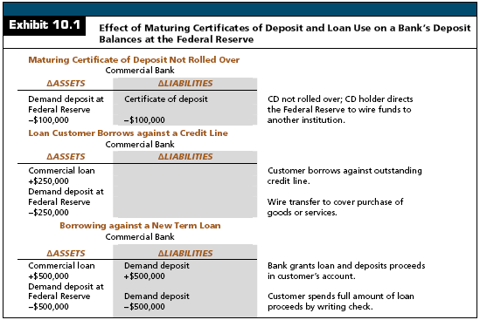

Slide 141
The Relationship Between Liquidity Requirements, Cash, and Funding Sources
Recent Trends in Bank Funding Sources
Bank customers have become more rate conscious
Many customers have demonstrated a a strong preference for shorter-term deposits
Core deposits are viewed as increasingly valuable
Bank often issue hybrid CDs to appeal to rate sensitive depositors

Slide 142
The Relationship Between Liquidity Requirements, Cash, and Funding Sources
Recent Trends in Bank Funding Sources
Retail Funding
Deposit Accounts
Transaction accounts
Money market deposit accounts
Savings accounts
Small time deposits

Slide 143
The Relationship Between Liquidity Requirements, Cash, and Funding Sources
Recent Trends in Bank Funding Sources
Borrowed Funding
Federal Funds purchased
Repurchase agreements
Federal Home Loan Bank borrowings

Slide 144
The Relationship Between Liquidity Requirements, Cash, and Funding Sources
Recent Trends in Bank Funding Sources
Wholesale Funding
Includes borrowed funds plus large CDs
Equity Funding
Common stock
Preferred stock
Retained earnings

Slide 145
The Relationship Between Liquidity Requirements, Cash, and Funding Sources
Recent Trends in Bank Funding Sources
Volatile (Managed) Liabilities
Funds purchased from rate-sensitive investors
Federal Funds purchased
Repurchase agreements
Jumbo CDs
Eurodollar time deposits
Foreign Deposits
Investors will move their funds if other institutions are paying higher rates

Slide 146
The Relationship Between Liquidity Requirements, Cash, and Funding Sources
Recent Trends in Bank Funding Sources
Core Deposits
Stable deposits that customers are less likely to withdraw when interest rates on competing investments rise
Includes:
Transactions accounts
MMDAs
Savings accounts
Small CDs

Slide 147
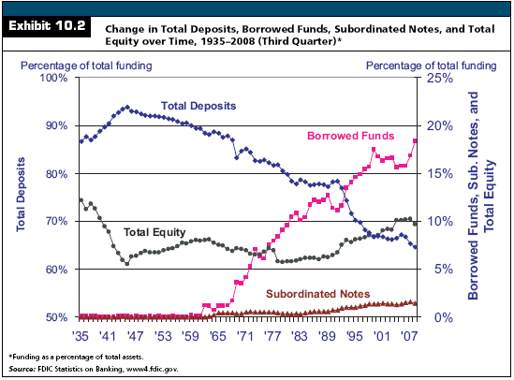

Slide 148
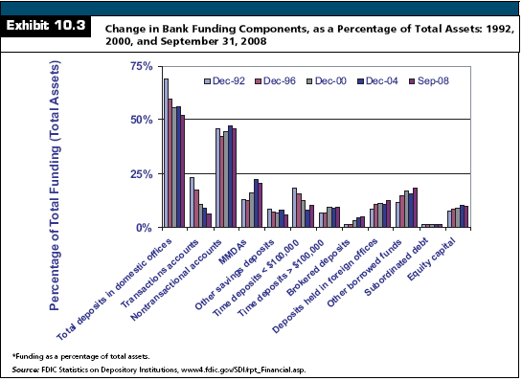

Slide 149
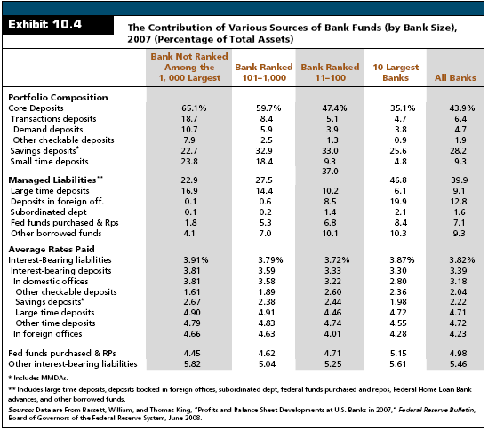

Slide 150
Characteristics of Retail-Type Deposits
Retail Deposits
Small denomination (under $100,000) liabilities
Normally held by individual investors
Not actively traded in the secondary market

Slide 151
Characteristics of Retail-Type Deposits
Transaction Accounts
Most banks offer three different transaction accounts
Demand Deposits
DDAs
Negotiable Order of Withdrawal
NOWs
Automatic Transfers from Savings
ATS

Slide 152
Characteristics of Retail-Type Deposits
Transaction Accounts
Demand Deposits
Checking accounts that do not pay interest
Held by individuals, business, and governmental units
Most are held by businesses since Regulation Q prohibits banks from paying explicit interest on for-profit corporate checking accounts

Slide 153
Characteristics of Retail-Type Deposits
Transaction Accounts
NOW Accounts
Checking accounts that pay interest
ATS Accounts
Customer has both a DDA and savings account
The bank transfers enough from savings to DDA each day to force a zero balance in the DDA account
For-profit corporations are prohibited from owning NOW and ATS accounts

Slide 154
Characteristics of Retail-Type Deposits
Transaction Accounts
Although the interest cost of transaction accounts is very low, the non-interest costs can be quite high
Generally, low balance checking accounts are not profitable for banks due to the high cost of processing checks

Slide 155
Characteristics of Retail-Type Deposits
Nontransactional Accounts
Non-transaction accounts are interest-bearing with limited or no check-writing privileges

Slide 156
Characteristics of Retail-Type Deposits
Nontransactional Accounts
Money Market Deposit Accounts
Pay interest but holders are limited to 6 transactions per month, of which only three can be checks
Attractive to banks because they are not required to hold reserves against MMDAs

Slide 157
Characteristics of Retail-Type Deposits
Nontransactional Accounts
Savings Accounts
Have no fixed maturity
Small Time Deposits (Retail CDs)
Have a specified maturity ranging from 7 days on up
Large Time Deposits (Jumbo CDs)
Negotiable CDs of $100,000 or more
Typically can be traded in the secondary market

Slide 158
Characteristics of Retail-Type Deposits
Estimating the Cost of Deposit Accounts
Interest Costs
Legal Reserve Requirements
Check Processing Costs
Account Charges
NSF fees
Monthly fees
Per check fees

Slide 159
Characteristics of Retail-Type Deposits
Estimating the Cost of Deposit Accounts
Transaction Account Cost Analysis
Classifies check-processing as:
Deposits
Electronic
Non-Electronic
Withdrawals
Electronic
Non-Electronic

Slide 160
Characteristics of Retail-Type Deposits
Estimating the Cost of Deposit Accounts
Transaction Account Cost Analysis
Classifies check-processing as:
Transit Checks
Deposited
Cashed
Account Opened or Closed
On-Us checks cashed
General account maintenance
Truncated
Non-Truncated

Slide 161
Characteristics of Retail-Type Deposits
Estimating the Cost of Deposit Accounts
Transaction Account Cost Analysis
Electronic Transactions
Conducted through automatic deposits, Internet, and telephone bill payment
Non-Electronic Transactions
Conducted in person or by mail
Transit Checks
Checks drawn on any bank other than the bank it was deposited into

Slide 162
Characteristics of Retail-Type Deposits
Estimating the Cost of Deposit Accounts
Transaction Account Cost Analysis
On-Us Checks Cashed
Checks drawn on the bank’s own customer’s accounts
Deposits
Checks or currency directly deposited in the customer's account
Account Maintenance
General record maintenance and preparing & mailing a periodic statement

Slide 163
Characteristics of Retail-Type Deposits
Estimating the Cost of Deposit Accounts
Transaction Account Cost Analysis
Truncated Account
A checking account in which the physical check is ‘truncated’ at the bank and the checks are not returned to the customer
Official Check Issued
A check for certified funds.
Net Indirect Costs
Those costs not directly related to the product such as management salaries or general overhead costs

Slide 164
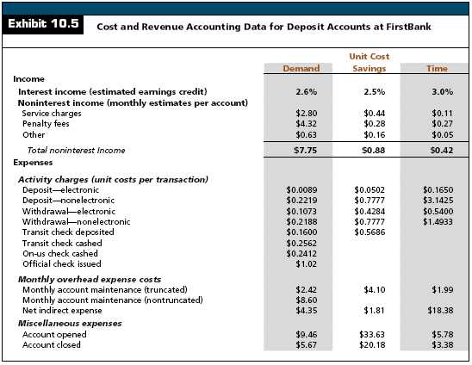

Slide 165
Characteristics of Retail-Type Deposits
Calculating the Average Net Cost of Deposit Accounts
Average Historical Cost of Funds
Measure of average unit borrowing costs for existing funds
Average Interest Cost
Calculated by dividing total interest expense by the average dollar amount of liabilities outstanding

Slide 166
Characteristics of Retail-Type Deposits
Calculating the Average Net Cost of Deposit Accounts

Slide 167
Characteristics of Retail-Type Deposits
Calculating the Average Net Cost of Deposit Accounts
Example:
If a demand deposit account does not pay interest, has $20.69 in transaction costs charges, $7.75 in fees, an average balance of $5,515, and 5% float, what is the net cost of the deposit?

Slide 168
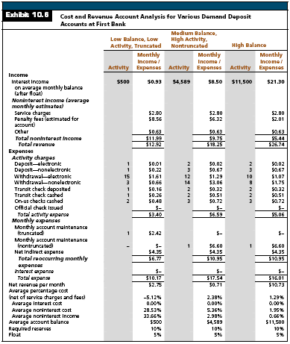

Slide 169
Characteristics of Large Wholesale Deposits
Wholesale Liabilities
Customers move these investments on the basis of small rate differentials, so these funds are labeled:
Hot Money
Volatile Liabilities
Short-Term Non-Core funding

Slide 170
Characteristics of Large Wholesale Deposits
Wholesale Liabilities
Jumbo CDs
$100,000 or more
Negotiable
Can be traded on the secondary market
Minimum maturity of 7 days
Interest rates quoted on a 360-day year basis
Insured up to $100,000 per investor per institution
Issued directly or indirectly through a dealer or broker (Brokered Deposits)

Slide 171
Characteristics of Large Wholesale Deposits
Wholesale Liabilities
Jumbo CDs
Fixed-Rate
Variable-Rate
Jump Rate (Bump-up) CD
Depositor has a one-time option until maturity to change the rate to the prevailing market rate

Slide 172
Characteristics of Large Wholesale Deposits
Wholesale Liabilities
Jumbo CDs
Callable
Zero Coupon
Stock Market Indexed
Rate tied to stock market index performance
Rate Boards
Represent venues for selling non-brokered CDs via the Internet to institutional investors
Rate boards help raise funds quickly and represent a virtual branch for a bank

Slide 173
Characteristics of Large Wholesale Deposits
Individual Retirement Accounts
Each year, a wage earner can make a tax-deferred investment up to $8,000 of earned income
Funds withdrawn before age 59 ½ are subject to a 10% IRS penalty
This makes IRAs an attractive source of long-term funding for banks

Slide 174
Characteristics of Large Wholesale Deposits
Foreign Office Deposits
Eurocurrency
Financial claim denominated in a currency other than that of the country where the issuing bank is located
Eurodollar
Dollar-denominated financial claim at a bank outside the U.S.
Eurodollar deposits
Dollar-denominated depots in banks outside the U.S.

Slide 175
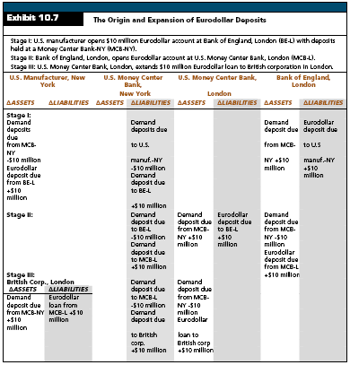

Slide 176
Characteristics of Large Wholesale Deposits
Borrowing Immediately Available Funds
Federal Funds Purchased
The term Fed Funds is often used to refer to excess reserve balances traded between banks
This is grossly inaccurate, given reserves averaging as a method of computing reserves, different non-bank players in the market, and the motivation behind many trades
Most transactions are overnight loans, although maturities are negotiated and can extend up to several weeks
Interest rates are negotiated between trading partners and are quoted on a 360-day basis

Slide 177
Characteristics of Large Wholesale Deposits
Borrowing Immediately Available Funds
Security Repurchase Agreements (RPs or Repos)
Short-term loans secured by government securities that are settled in immediately available funds
Identical to Fed Funds except they are collateralized
Technically, the RPs entail the sale of securities with a simultaneous agreement to buy them back later at a fixed price plus accrued interest

Slide 178
Characteristics of Large Wholesale Deposits
Borrowing Immediately Available Funds
Security Repurchase Agreements (RPs or Repos)
Most transactions are overnight
In most cases, the market value of the collateral is set above the loan amount when the contract is negotiated.
This difference is labeled the margin
The lender’s transaction is referred to as a Reverse Repo

Slide 179
Characteristics of Large Wholesale Deposits
Borrowing Immediately Available Funds
Structured Repurchase Agreements
Embeds an option (call, put, swap, cap, floor, etc.) in the instrument to either lower its initial cost to the borrower or better help the borrower match the risk and return profile of an investment
Flipper Repo
Carries a floating rate that will convert, or flip, to a fixed rate after some lock-out period

Slide 180
Characteristics of Large Wholesale Deposits
Borrowing From the Federal Reserve
Discount Window
Discount Rate
Policy is to set discount rate 1% (1.5%) over the Fed Funds target for primary (secondary) credit loans
To borrow from the Federal Reserve, banks must apply and provide acceptable collateral before the loan is granted
Eligible collateral includes U.S. government securities, bankers acceptances, and qualifying short-term commercial or government paper

Slide 181
Characteristics of Large Wholesale Deposits
Borrowing From the Federal Reserve
Discount Rate
Current Interest Rates 9/09/2009
Primary Credit | 0.50%
Secondary Credit | 1.00%
Seasonal Credit | 0.25%
Fed Funds Target | 0 - 0.25%

Slide 182
Characteristics of Large Wholesale Deposits
Borrowing From the Federal Reserve
Primary Credit
Available to sound depository institutions on a short-term basis to meet short-term funding needs

Slide 183
Characteristics of Large Wholesale Deposits
Borrowing From the Federal Reserve
Secondary Credit
Available to depository institutions that are not eligible for primary credit
Available to meet backup liquidity needs when its use is consistent with a timely return to a reliance on market sources of funding or the orderly resolution of a troubled institution

Slide 184
Characteristics of Large Wholesale Deposits
Borrowing From the Federal Reserve
Seasonal Credit
Designed to assist small depository institutions in managing significant seasonal swings in their loans and deposits

Slide 185
Characteristics of Large Wholesale Deposits
Borrowing From the Federal Reserve
Emergency Credit
May be authorized in unusual and exigent circumstances by the Board of Governors to individuals, partnerships, and corporations that are not depository institutions

Slide 186
Characteristics of Large Wholesale Deposits
Other Borrowing from the Federal Reserve
Term Auction Facility
Allows banks to bid for an advance that will generally have a 28-day maturity
Banks must post collateral against the borrowings and cannot prepay the loan

Slide 187
Characteristics of Large Wholesale Deposits
Other Borrowing from the Federal Reserve
Term Securities Lending Facility
A facility in which the Open Market Trading Desk of the Federal Reserve Bank of New York makes loans to primary securities dealers

Slide 188
Characteristics of Large Wholesale Deposits
Federal Home Loan Bank Advances
The FHLB system is a government-sponsored enterprise created to assist in home buying
The FHLB system is one of the largest U.S. financial institutions, rated AAA because of the government sponsorship
Any bank can become a member of the FHLB system by buying FHLB stock
If it has the available collateral, primarily real estate related loans, it can borrow from the FHLB
FHLB advances have maturities from 1 day to as long as 20 years

Slide 190
Electronic Money
Intelligent Card
Contains a microchip with the ability to store and secure information
Memory Card
Simply store information

Slide 191
Electronic Money
Debit Card
Online
PIN based
Transaction goes through the ATM system
Offline
Signature based transactions
Transaction goes through the credit card system

Slide 192
Electronic Money
Electronic Funds Transfer (EFT)
An electronic movement of financial data, designed to eliminate the paper instruments normally associated with such funds movement
Types of EFT
ACH: Automated Clearing House
POS: Point of Sale
ATM
Direct Deposit
Telephone Bill Paying
Automated Merchant Authorization Systems
Preauthorized Payments

Slide 193
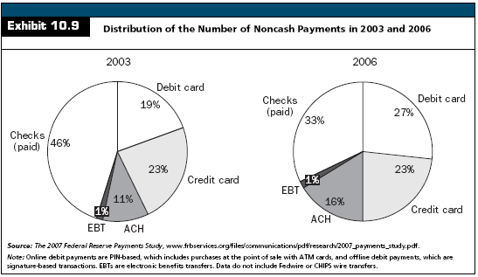

Slide 194
Check 21
Check Clearing for the 21st Century Act
Facilitates check truncation by reducing some of the legal impediments
Foster innovation in the payments and check collection system without mandating receipt of check in electronic form
Improve the overall efficiency of the nation’s payment system

Slide 195
Check 21
Check Truncation
Conversion of a paper check into an electronic debit or image of the check by a third party in the payment system other than the paying bank
Facilitates check truncation by creating a new negotiable instrument called a substitute check

Slide 196
Check 21
Substitute Check
The legal equivalent of the original check and includes all the information contained on the original
Check 21 does NOT require banks to accept checks in electronic form nor does it require banks to create substitute checks
It does allow banks to handle checks electronically instead of physically moving paper checks

Slide 197
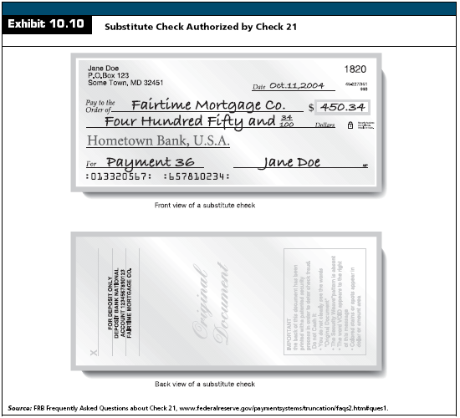

Slide 198
Check 21
Check Clearing Process
Banks typically place a hold on a check until it verifies that the check is “good”
Expedited Funds Availability Act
Under Reg CC, it states that:
Local check must clear in no more than two business days
Non-local checks must clear in no more than five business days
Government, certified, and cashiers checks must be available by 9 a.m. the next business day

Slide 199
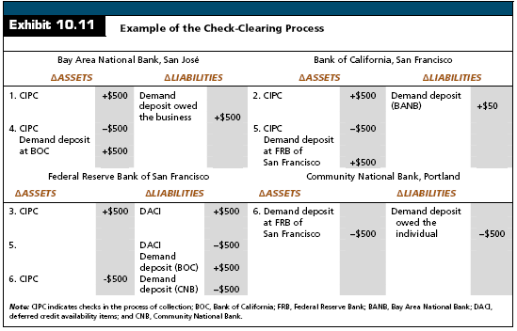

Slide 200
Measuring the Cost of Funds
Average Historical Cost of Funds
Many banks incorrectly use the average historical costs in their pricing decisions
The primary problem with historical costs is that they provide no information as to whether future interest costs will rise or fall.
Pricing decisions should be based on marginal costs compared with marginal revenues

Slide 201
Measuring the Cost of Funds
The Marginal Cost of Funds
Marginal Cost of Debt
Measure of the borrowing cost paid to acquire one additional unit of investable funds
Marginal Cost of Equity
Measure of the minimum acceptable rate of return required by shareholders
Marginal Cost of Funds
The marginal costs of debt and equity

Slide 202
Measuring the Cost of Funds
The Marginal Cost of Funds
Costs of Independent Sources of Funds
It is difficult to measure marginal costs precisely
Management must include both the interest and noninterest costs it expects to pay and identify which portion of the acquired funds can be invested in earning assets

Slide 203
Measuring the Cost of Funds
The Marginal Cost of Funds
Costs of Independent Sources of Funds
Marginal costs may be defined as :

Slide 204
Measuring the Cost of Funds
The Marginal Cost of Funds
Costs of Independent Sources of Funds
Example:
Market interest rate is 2.5%
Servicing costs are 4.1% of balances
Acquisition costs are 1.0% of balances
Deposit insurance costs are 0.25% of balances
Net investable balance is 85% of the balance (10% required reserves and 5% float)

Slide 205
Measuring the Cost of Funds
The Marginal Cost of Funds
Costs of Independent Sources of Funds
Example:

Slide 206
Measuring the Cost of Funds
The Marginal Cost of Funds
Costs of Independent Sources of Funds
Cost of Debt
Equals the effective cost of borrowing from each source, including interest expense and transactions costs
This cost is the discount rate, which equates the present value of expected interest and principal payments with the net proceeds to the bank from the issue

Slide 207
Measuring the Cost of Funds
The Marginal Cost of Funds
Costs of Independent Sources of Funds
Cost of Debt
Example:
Assume the bank will issue:
$10 million in par value subordinated notes paying $700,000 in annual interest and a 7-year maturity
It must pay $100,000 in flotation costs to an underwriter
The effective cost of borrowing (kd) is 7.19%

Slide 208
Measuring the Cost of Funds
The Marginal Cost of Funds
Costs of Independent Sources of Funds
Cost of Debt
Example:

Slide 209
Measuring the Cost of Funds
The Marginal Cost of Funds
Costs of Independent Sources of Funds
Cost of Equity
The marginal cost of equity equals the required return to shareholders
It is not directly measurable because dividend payments are not mandatory

Slide 210
Measuring the Cost of Funds
The Marginal Cost of Funds
Costs of Independent Sources of Funds
Cost of Equity
Several methods are commonly used to approximate this required return:
Dividend Valuation Model
Capital Asset Pricing Model (CAPM)
Targeted Return on Equity Model
Cost of Debt + Risk Premium

Slide 211
Measuring the Cost of Funds
The Marginal Cost of Funds
Costs of Independent Sources of Funds
Cost of Preferred Stock
Preferred stock acts as a hybrid of debt and common equity
Claims are superior to those of common stockholders but subordinated to those of debt holders
Preferred stock pays dividends that may be deferred when management determines that earnings are too low.
The marginal cost of preferred stock can be approximated in the same manner as the Dividend Valuation Model however, dividend growth is zero

Slide 212
Measuring the Cost of Funds
The Marginal Cost of Funds
Costs of Independent Sources of Funds
Trust Preferred Stock
Trust preferred stock is attractive because it effectively pays dividends that are tax deductible
This loan interest is tax deductible such that the bank effectively gets to deduct dividend payments as the preferred stock

Slide 213
Measuring the Cost of Funds
Weighted Marginal Cost of Total Funds
This is the best cost measure for asset-pricing purposes
It recognizes both explicit and implicit costs associated with any single source of funds

Slide 214
Measuring the Cost of Funds
Weighted Marginal Cost of Total Funds
It assumes that all assets are financed from a pool of funds and that specific sources of funds are not tied directly to specific uses of funds

Slide 215
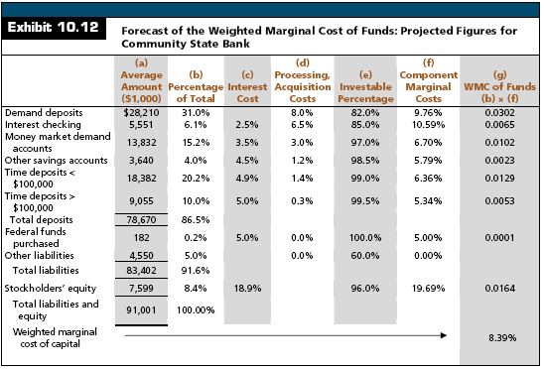

Slide 216
Funding Sources and Banking Risks
Banks face two fundamental problems in managing liabilities. Uncertainty over:
What rates they must pay to retain and attract funds
The likelihood that customers will withdraw their money regardless of rates

Slide 217
Funding Sources and Banking Risks
Funding Sources: Liquidity Risk
The liquidity risk associated with a bank’s deposit base is a function of:
The competitive environment
Number of depositors
Average size of accounts
Location of the depositor
Specific maturity and rate characteristics of each account

Slide 218
Funding Sources and Banking Risks
Funding Sources: Liquidity Risk
Interest Elasticity
How much can market interest rates change before the bank experiences deposit outflows?
If a bank raises its rates, how many new funds will it attract?
Depositors often compare rates and move their funds between investment vehicles to earn the highest yields
It is important to note the liquidity advantage that stable core deposits provide a bank

Slide 219
Funding Sources and Banking Risks
Funding Sources: Interest Rate Risk
Many depositors and investors prefer short-term instruments that can be rolled over quickly as interest rates change
Banks must offer a substantial premium to induce depositors to lengthen maturities
Those banks that choose not to pay this premium will typically have a negative one-year GAP

Slide 220
Funding Sources and Banking Risks
Funding Sources: Interest Rate Risk
One strategy is to aggressively compete for retail core deposits
Individual are not as rate sensitive as corporate depositors and will often maintain their balances through rate cycles as long as the bank provides good service

Slide 221
Funding Sources and Banking Risks
Funding Sources: Credit and Capital Risk
Changes in the composition and cost of bank funds can indirectly affect a bank’s credit risk by forcing it to reduce asset quality
For example, banks that substitute purchased funds for lost demand deposits will often see their cost of funds rise
Rather than let their interest margins deteriorate, many banks make riskier loans at higher promised yields
While they might maintain their margins in the near-term, later loan losses typically rise with the decline in asset quality

